Slide 1
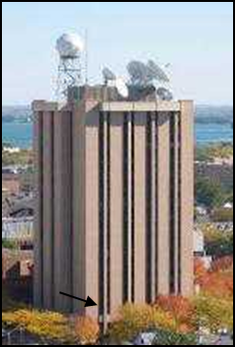
The Applications of Low Latency Direct Broadcast Satellite Data in Regional NWP
Jun Li¹, Pei Wang¹, Agnes Lim¹, and Timothy J. Schmit²
¹ Cooperative Institute for Meteorological Satellite Studies, University of Wisconsin-Madison
² Center for Satellite Applications and Research, NESDIS/NOAA
CSPP Users’ Group Meeting
25 – 27 June 2019
Chengdu, China
Acknowledgement: Supported by NOAA JPSS, GOES-R, and TMP Science Programs

Slide 2
Outline
Motivation;
Latency impact from polar orbit satellite observations on local severe storm forecast;
Application of GRB GEO advanced imager data in high impact weather forecast;
Summary

Slide 3
1. Motivation
The usefulness of numerical weather prediction (NWP) based high impact weather (HIW) forecast highly depends on how soon the forecast is updated. Therefore, the data latency is critical for assimilation in the regional NWP models;
The current polar orbit (LEO satellites (i.e., JPSS series, Metop series, FY3 series) have the capability for atmospheric sounding in the pre-convection environment, and low latency can be obtained through Direct Broadcast (DB) sites;
The geostationary (GEO) satellites (GOES-R series, Himarari-8/-9, FY-4 series, etc.) have the capability for monitoring moisture changes in pre-convection along with dynamic changes with high spatial and temporal resolutions, and real-time data can be obtained through receiving the geostationary rebroadcast (GRB) L1B data;
Those low latency data from LEO and GEO are very useful for improving the rapid changing weather forecasts through assimilating into high resolution regional NWP models.

Slide 4
2. Latency impact from polar orbit satellite on local severe storm (LSS) forecast
Using WRF as regional NWP model and NOAA GSI as data assimilation system;
All existing observations are assimilated as control run. Additional experiments using different latency restrictions are carried out for impact study;
Using ETS/POD/FAR scores to show the precipitation forecast of LSS; Using weighted RMSEs of T/Q/U/V compared with radiosonde to evaluate the LSS analysis and forecasts as well.

Slide 5
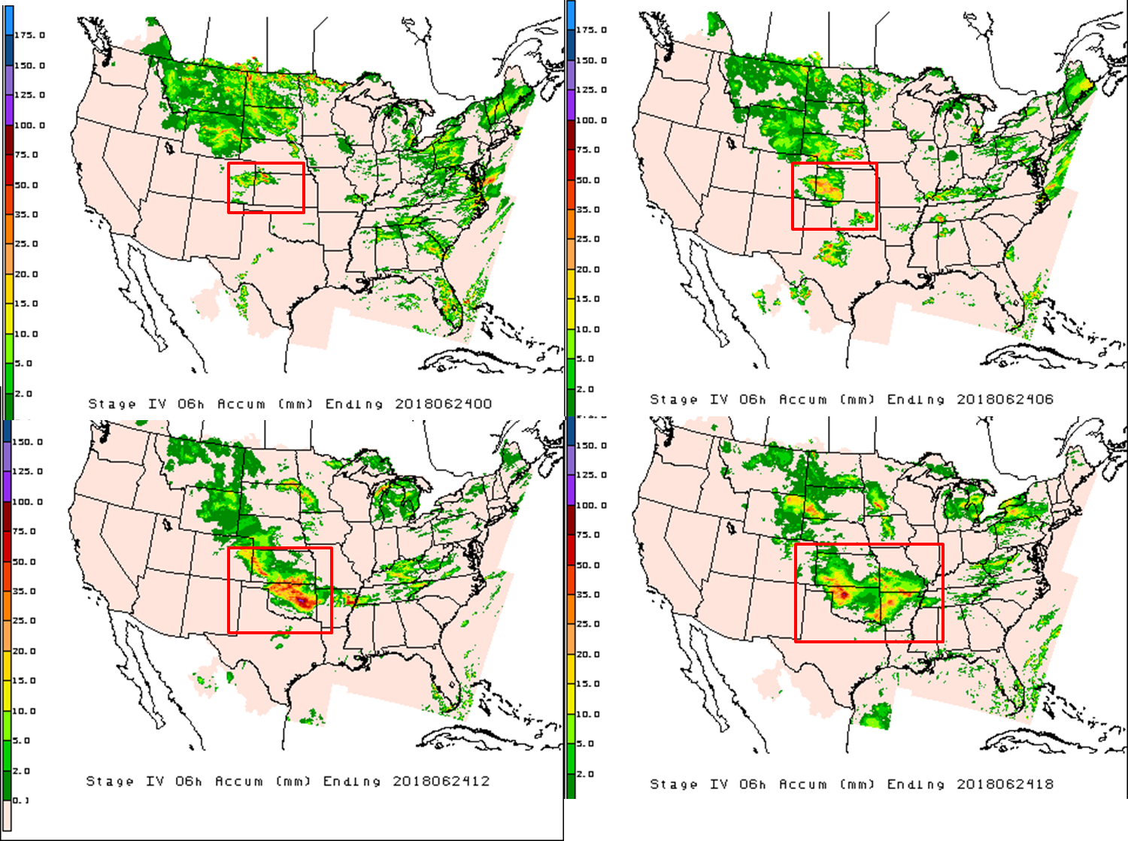
LSS case description
A typical LSS case starts from 0000 UTC 24 June to 1800 UTC 24 June 2018.

Slide 6
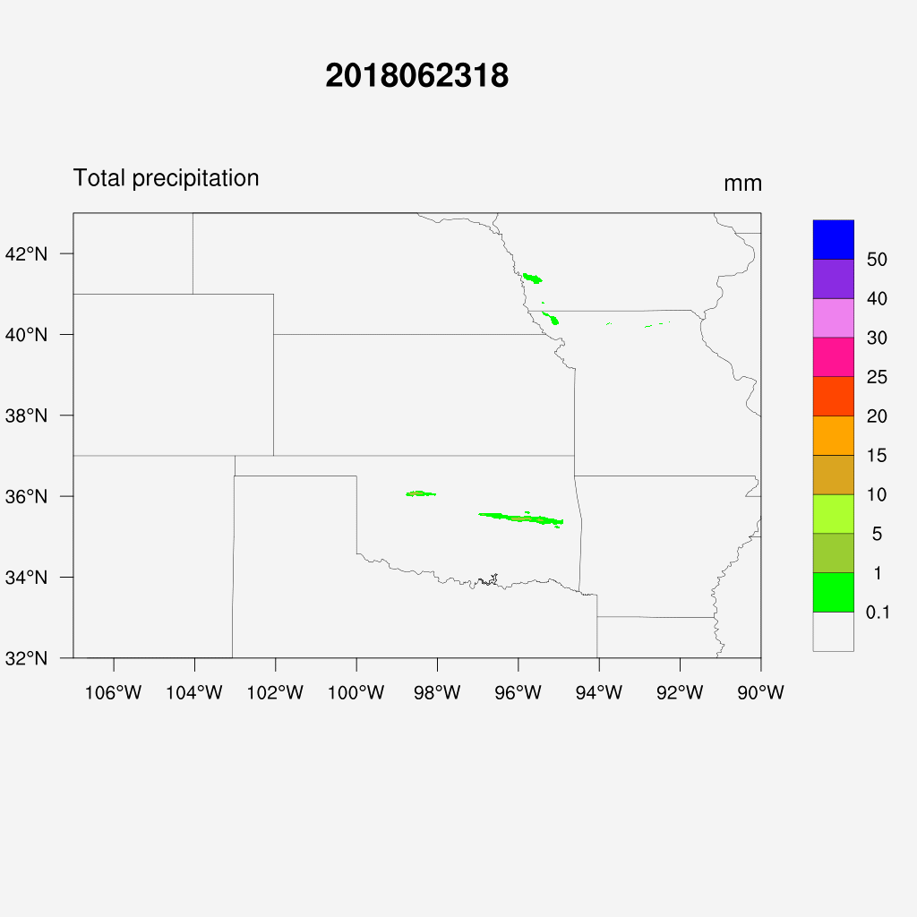
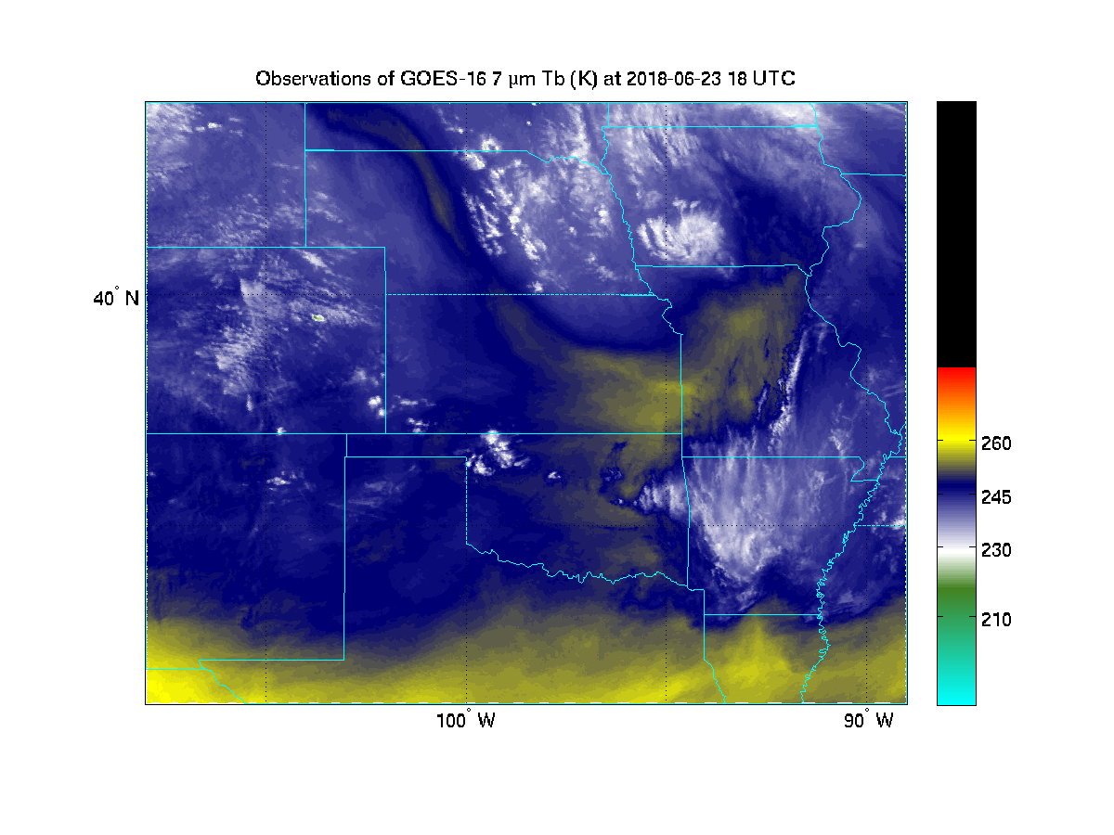
LSS case for impact study
Hourly accumulated precipitation from observations
GOES-16 ABI channel 9 Observations (K)

Slide 7
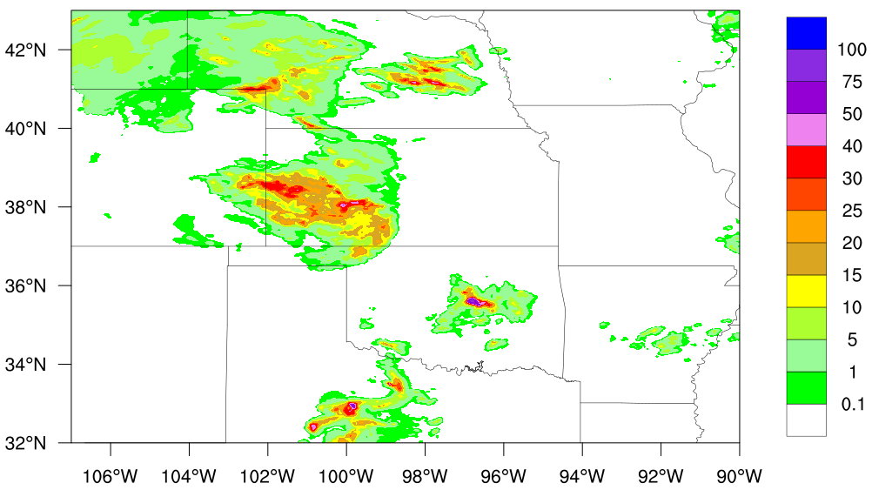
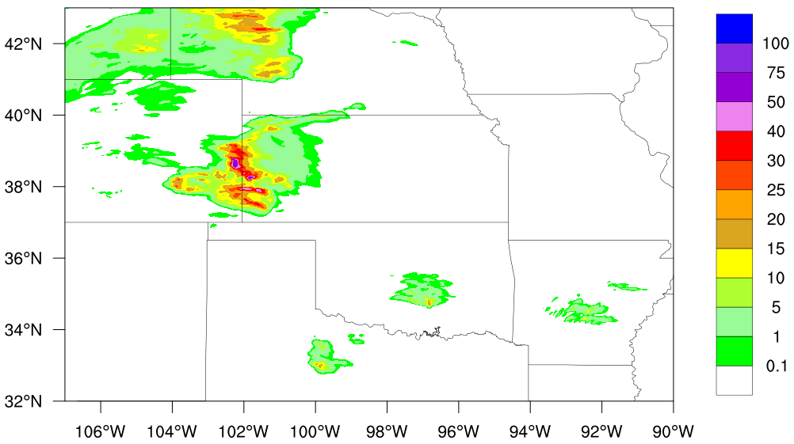
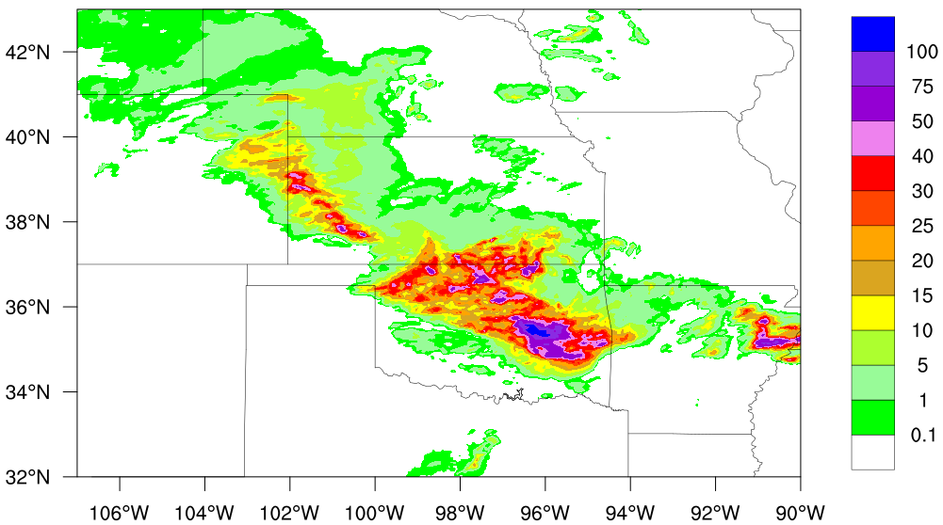
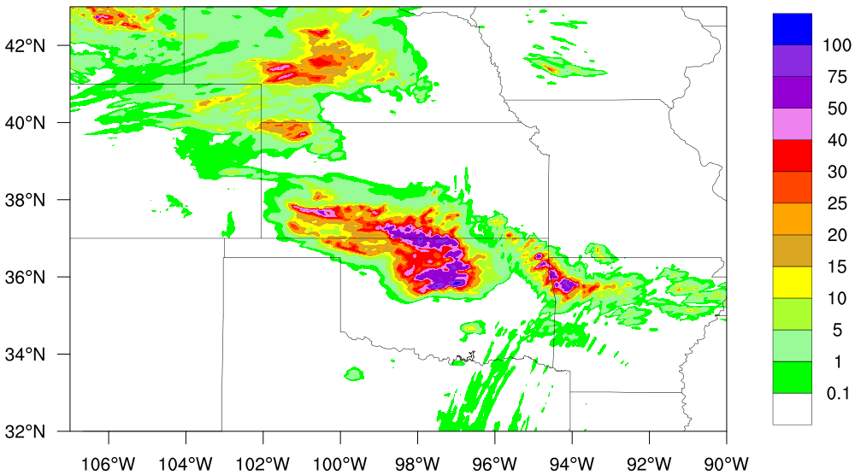
Experimental design
WRF-ARW v3.6.1:
9 km and 3 km horizontal resolution (RAP/HRRR setting)
52 vertical layers from surface to 10hPa
Microphysics scheme: Thompson aerosol-aware
Longwave & shortwave radiation: RRTMG
PBL scheme: Yonesei University scheme (YUS)
Observation precipitation
Simulated precipitation
0000 UTC 24 June to
0600 UTC 24 June
0600 UTC 24 June to
1200 UTC 24 June

Slide 8
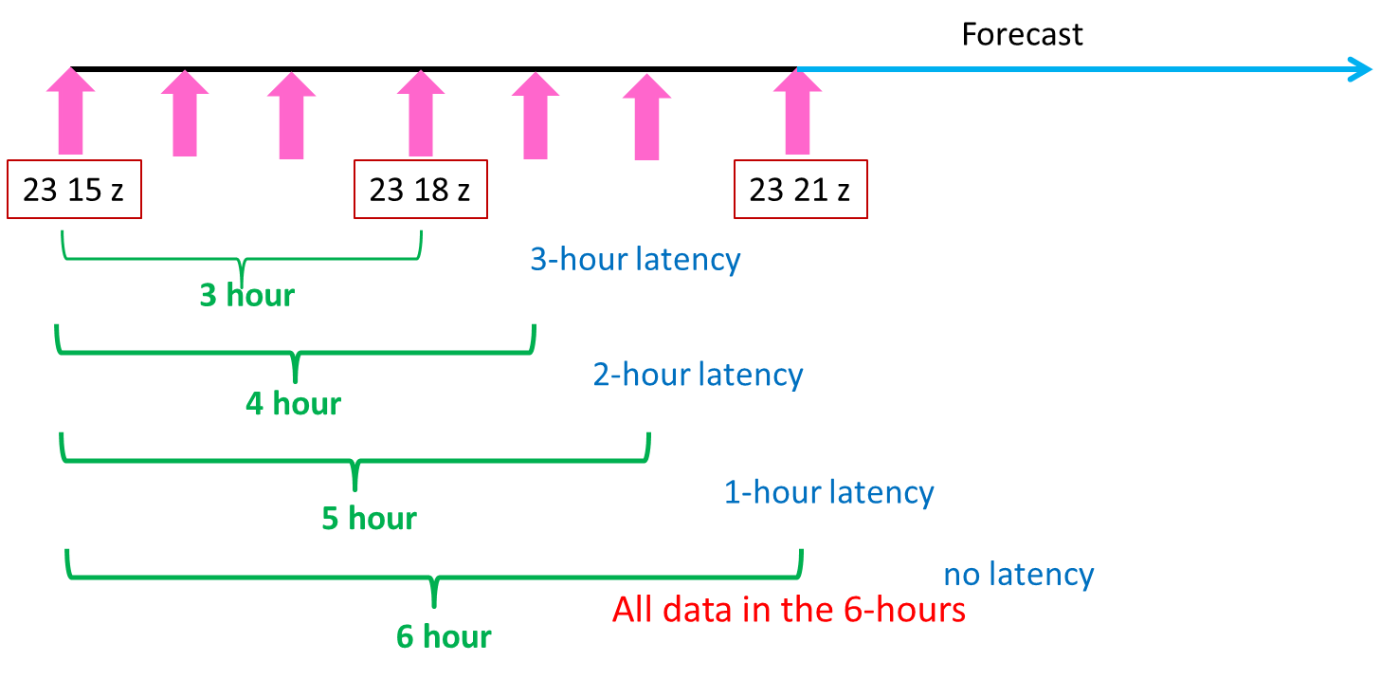
Experimental design
GSI-DTC v3.6:
Background field: NCEP global final analysis
Data thinning: 60-km
Background and observation error: global model
Satellite bias correction: enhanced bias correction method
Assimilated window: 3-hour
Assimilated data:
PrepBUFR
AMSU-A onboard NOAA-15, 18, 19, Metop-A, and Metop-B
ATMS onboard Suomi-NPP
CrIS onboard Suomi-NPP
IASI onboard Metop-A and Metop-B
Experiments
The assimilation time is at 23 21 z
The background field time is at 23 18 z
The available data are from
3-hour latency 23 15 z --- 23 18 z
2-hour latency 23 15 z --- 23 19 z
1-hour latency 23 15 z --- 23 20 z
No latency 23 15 z --- 23 21 z

Slide 9
Impacts on assimilated LEO data
The data coverages of each satellite are directly affected by the different data latency.
The following slides give some examples to show the data coverages of AMSU-A, ATMS, CrIS and IASI from 3-hour latency, 2-hour latency, 1-hour latency and no latency.

Slide 10
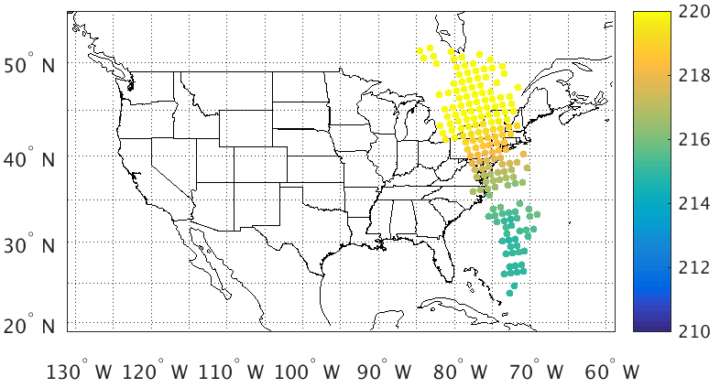
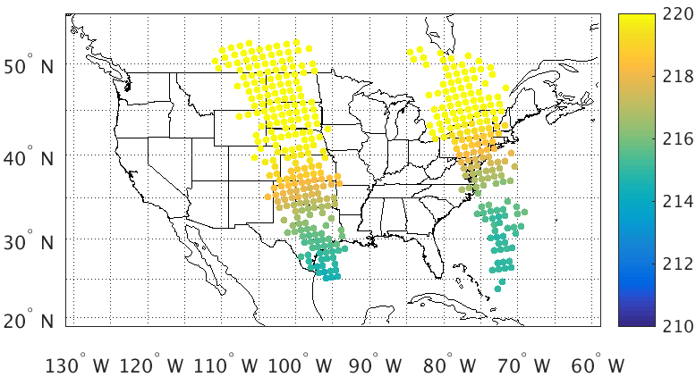
Data coverage of ATMS Ch 11
3 – hour latency
2 – hour latency
1 – hour latency
No latency

Slide 11
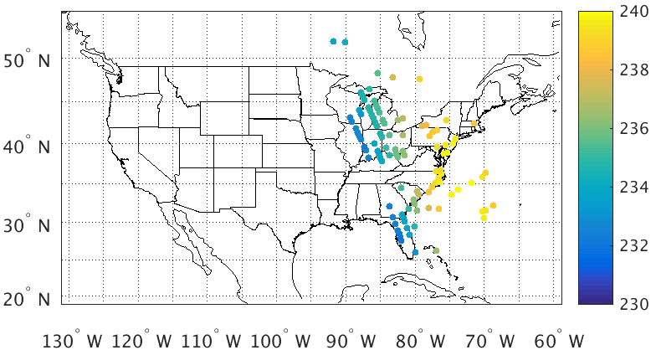
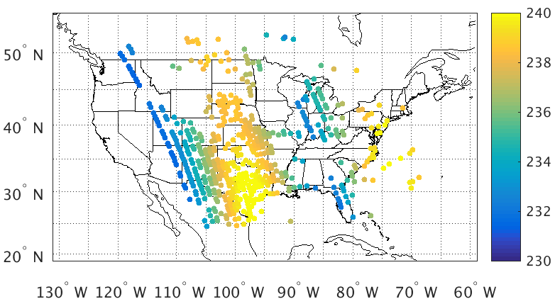
Data coverage of CrIS Ch 96
3 – hour latency
2 – hour latency
1 – hour latency
No latency

Slide 12
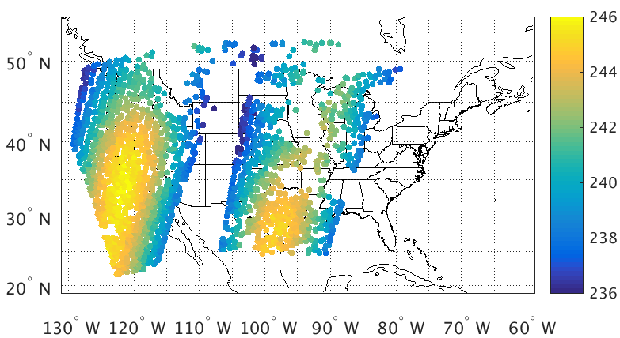
Data coverage of IASI a Ch 110
3 – hour latency
2 – hour latency
1 – hour latency
No latency

Slide 13
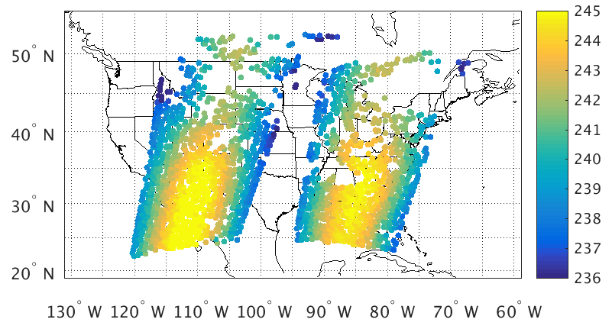
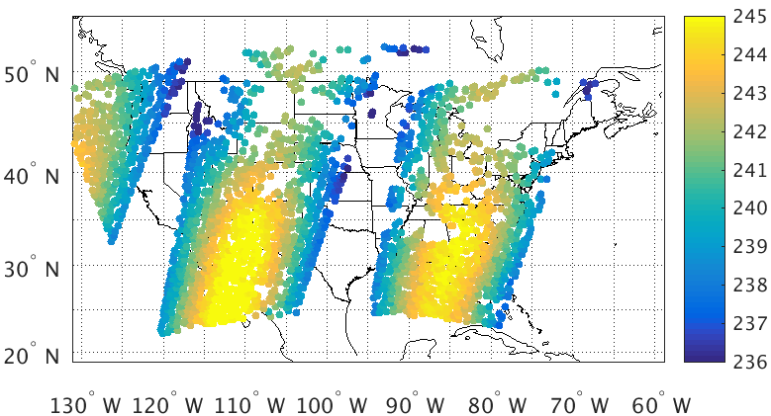
Data coverage of IASI b Ch 110
3 – hour latency
2 – hour latency
1 – hour latency
No latency

Slide 14
The data coverage increasing rate at analysis field
Satellite | 3-hour latency | 2-hour latency | 1-hour latency | No latency | (no latency – 3-hour latency) / no latency
AMSUA N15 Ch 6 | 141 | 141 | 141 | 141 | -----
AMSUA N18 Ch 6 | 1385 | 1383 | 1383 | 1384 | -----
AMSUA N19 Ch 6 | ----- | 101 | 101 | 114 | 100%
AMSUA MetopA Ch 6 | 2149 | 2150 | 2150 | 2150 | -----
AMSUA MetopB Ch 8 | 2365 | 2624 | 2624 | 2624 | 9.9%
ATMS Ch 11 | 500 | 500 | 1076 | 1075 | 53.5%
CrIS Ch 96 | 247 | 244 | 874 | 869 | 71.6%
IASI MetopA Ch 110 | 1774 | 1774 | 1745 | 1748 | -----
IASI MetopB Ch 110 | 1879 | 2210 | 2177 | 2175 | 13.6%

Slide 15
Impacts on precipitation forecast
3 scores are used to evaluate the precipitation forecast against observations
Equitable Threat Score (ETS)
$$ETS= \frac{Hits−Hits random}{Hits+Misses+False Alarms−Hits random}$$
$$Where Hits random= \frac{\left(Hits+False Alarms\right)(Hits+Misses)}{Total}$$
Probability of Detection (POD)
$$POD= \frac{Hits}{Hits+Misses}$$
False Alarm Ratio (FAR)
$$FAR= \frac{False Alarms}{Hits+False Alarms}$$
Contingency Table Used in Verification Statistics
Forecast | Observation
 | Yes | No
Yes | Hits (YY) | False alarms (YN)
No | Misses (NY) | Correct rejection (NN)

Slide 16
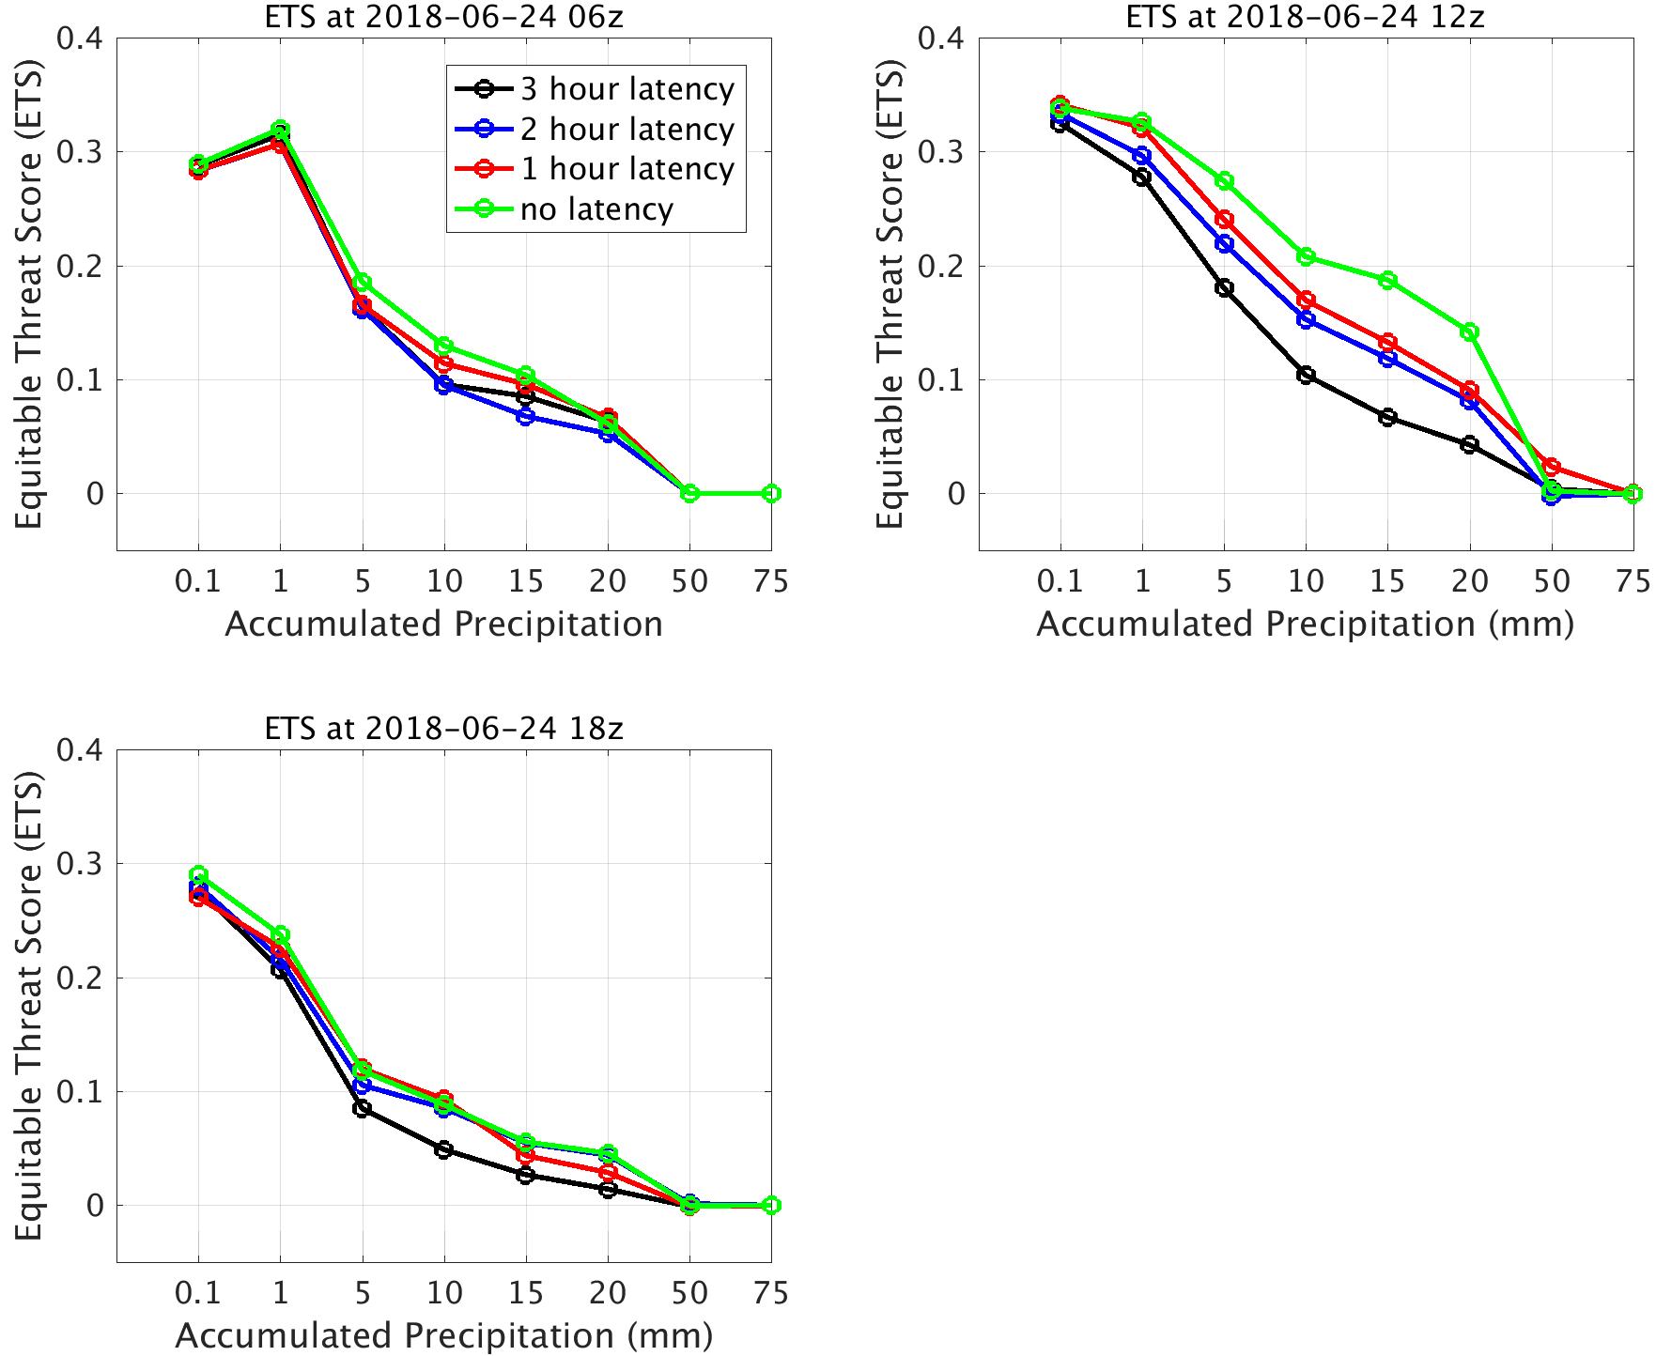
Impacts for the precipitation forecasts on every 6-hour

Slide 17
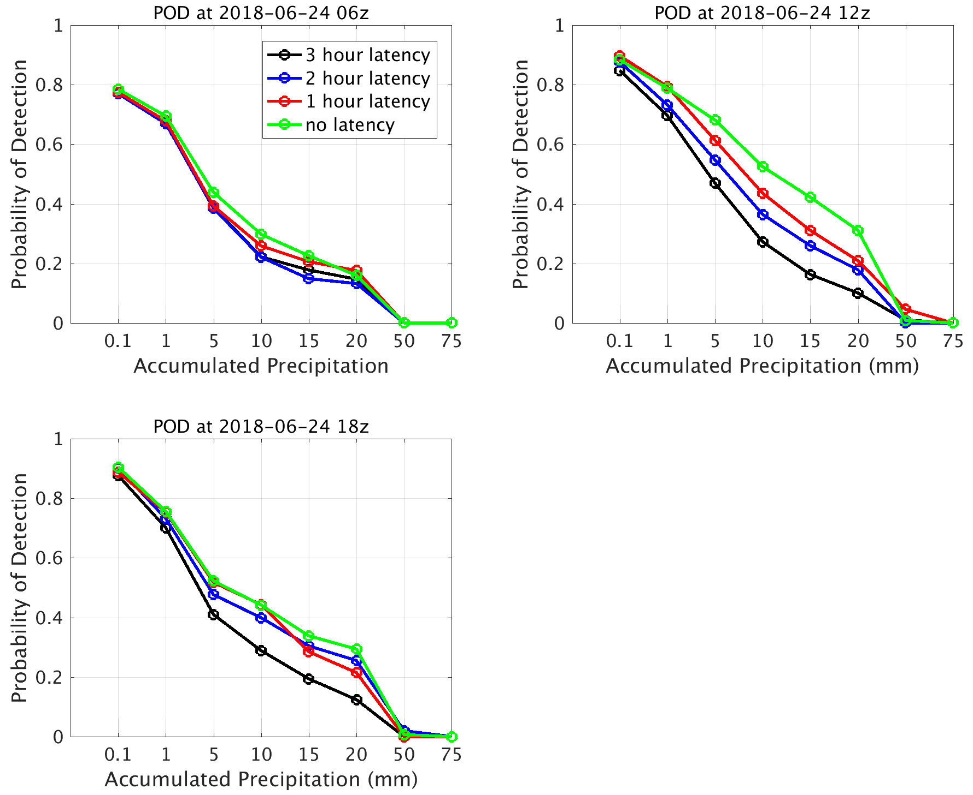
Impacts for the precipitation forecasts on every 6-hour

Slide 18
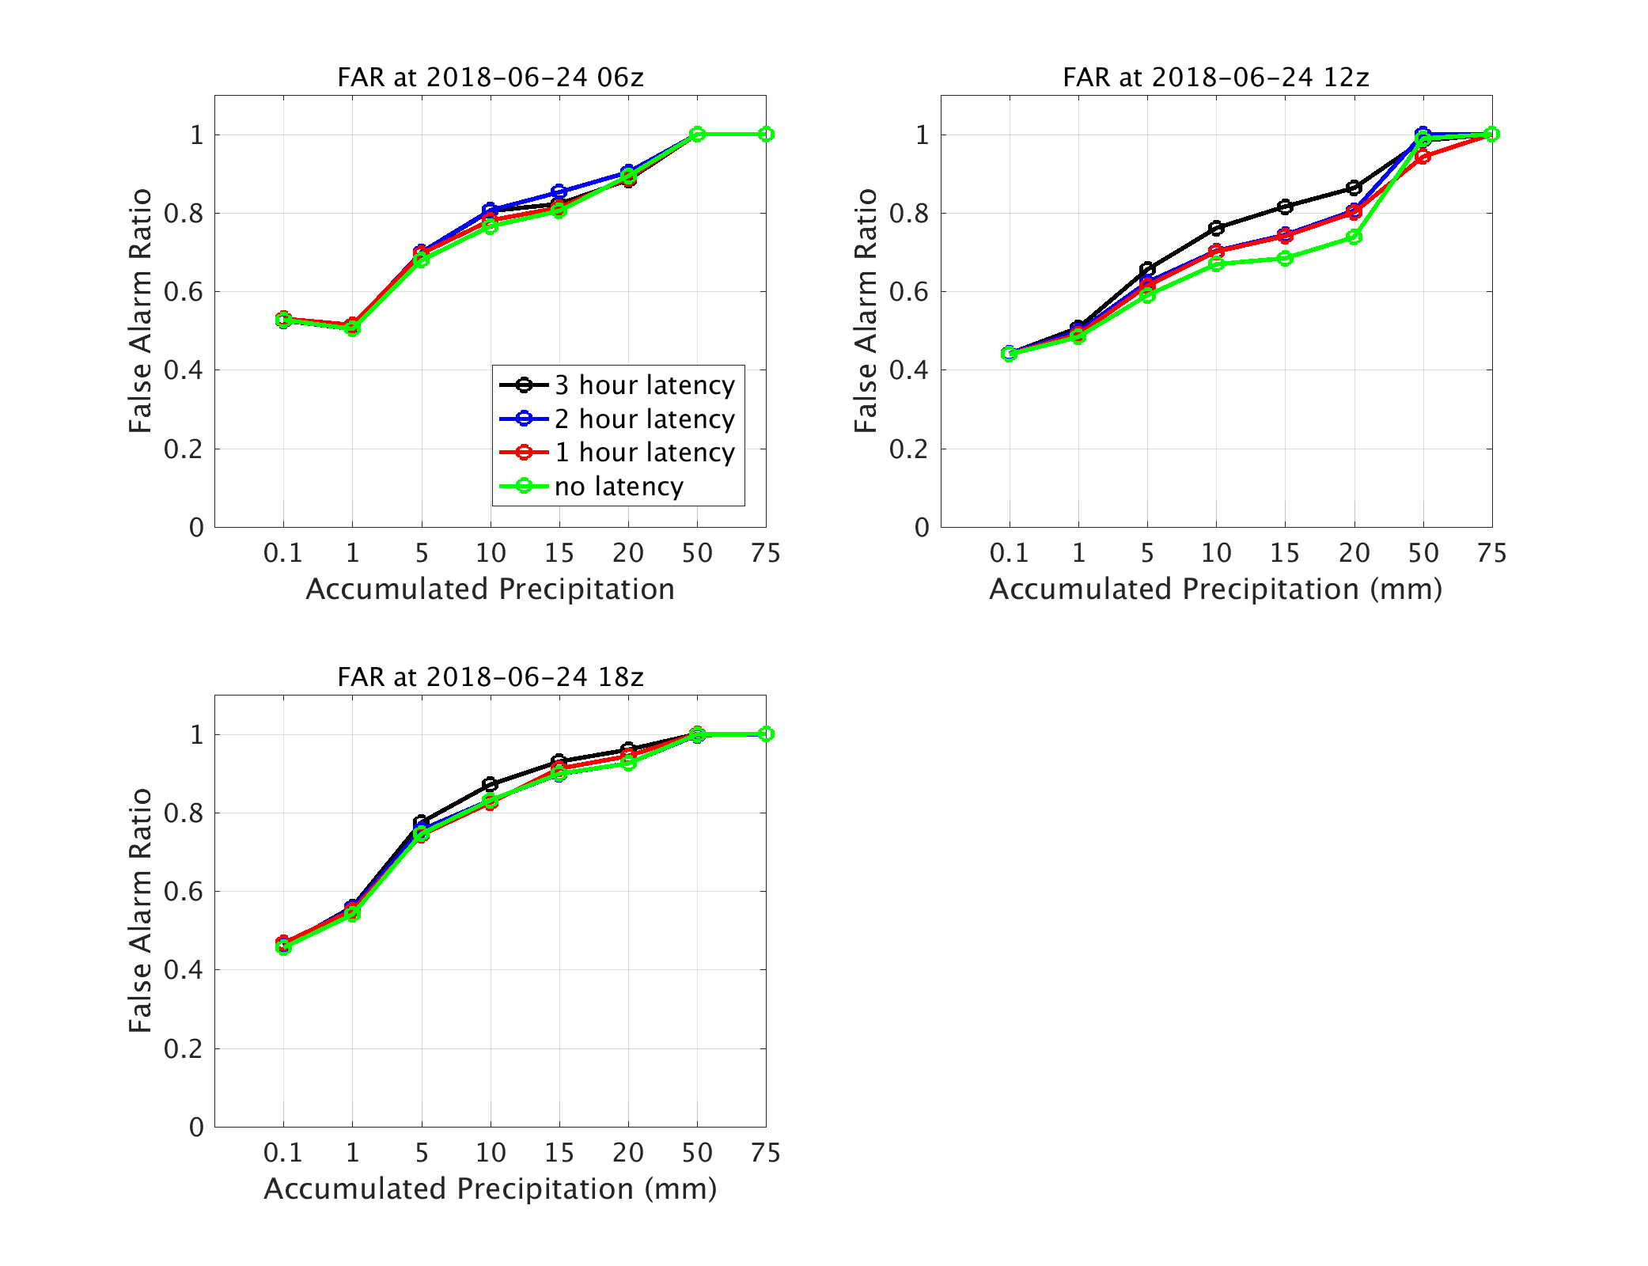
Impacts for the precipitation forecasts on every 6-hour

Slide 19
1-hour cumulative Precipitation
Observation
No latency

Slide 20
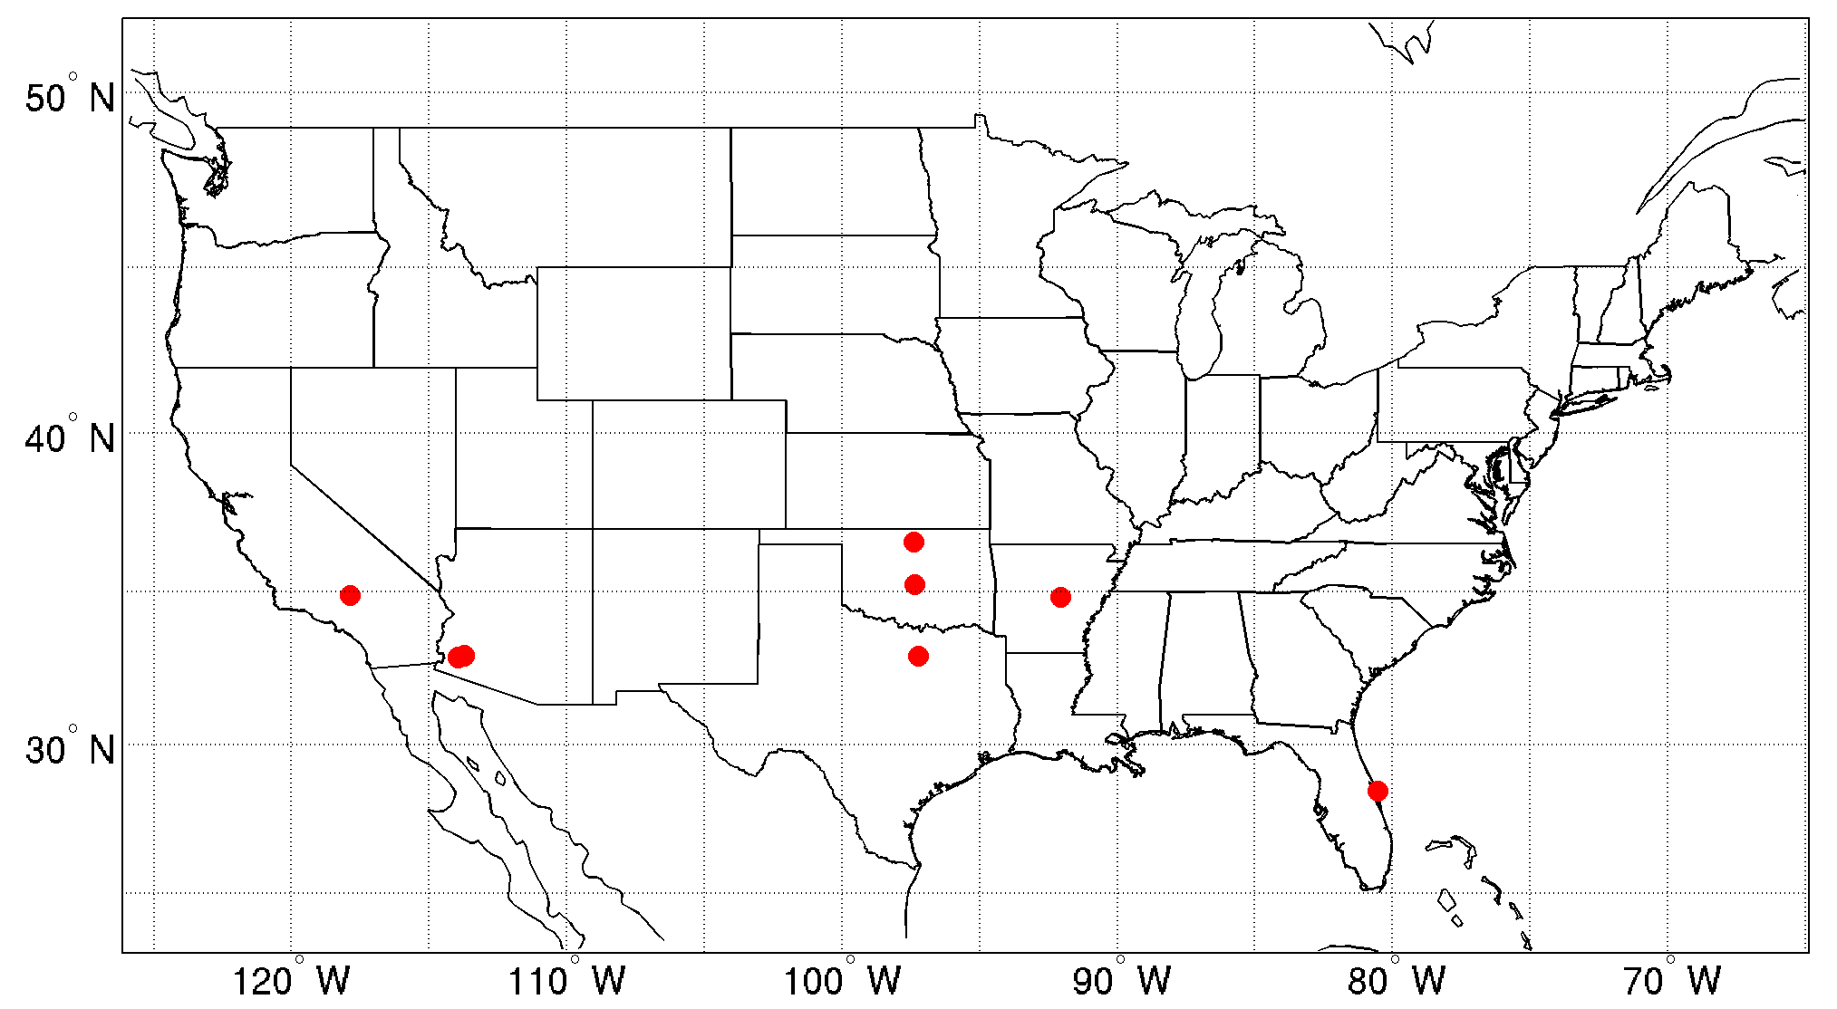
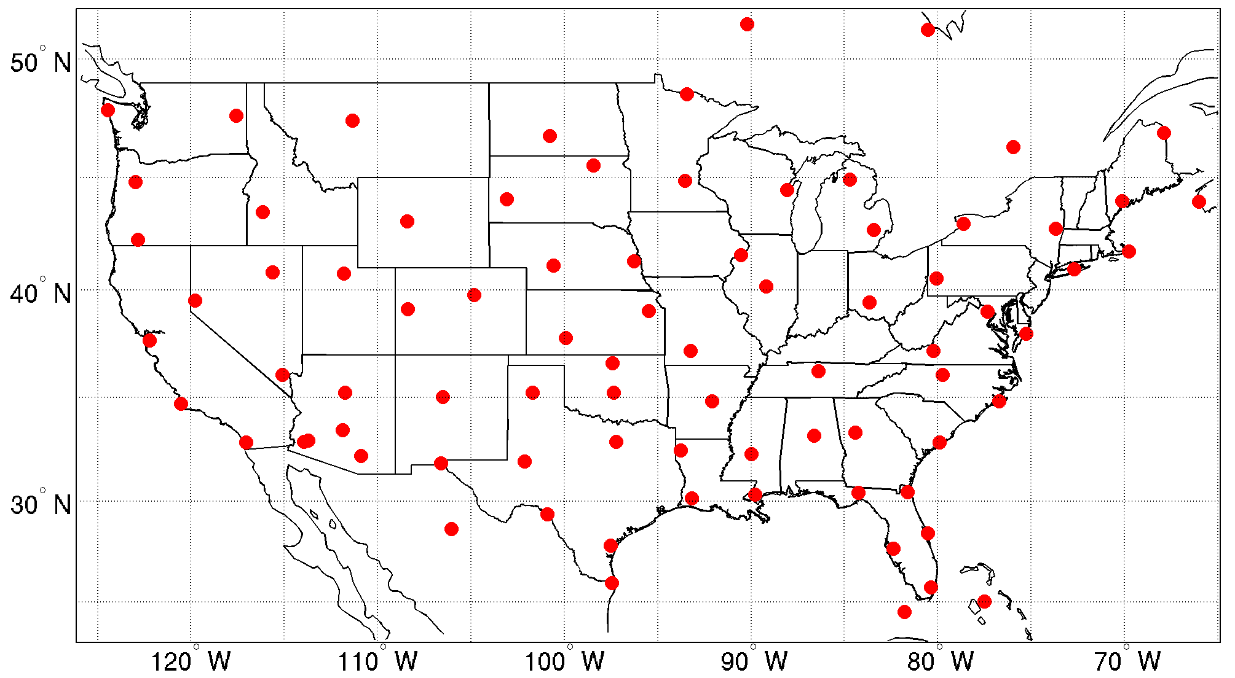
Impacts on forecast fields
Compare the forecast fields with radiosonde (T/Q/U/V) observations.
Radiosonde locations
2018-6-23 18z
2018-6-24 00z

Slide 21
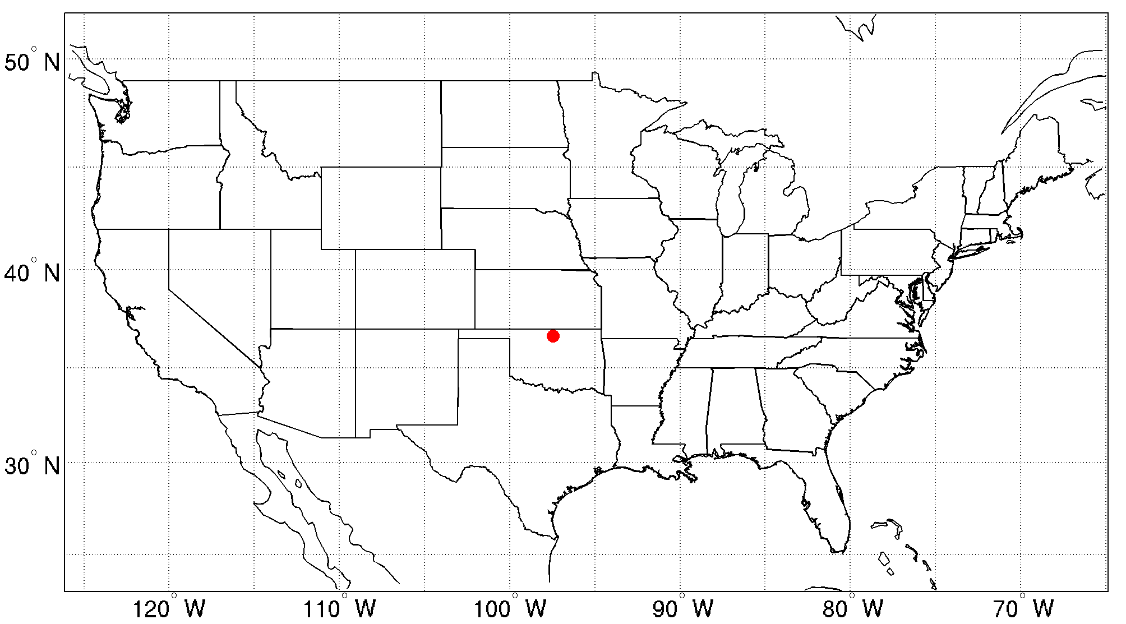
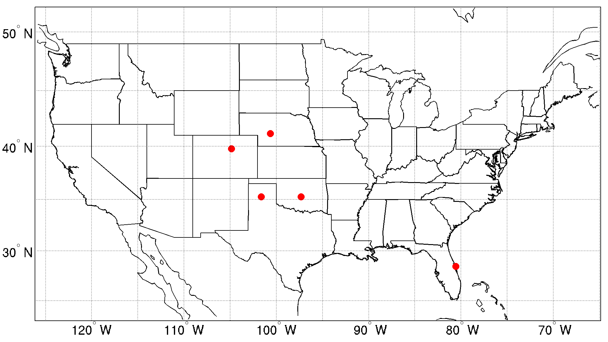
Radiosonde locations
2018-6-24 06z
2018-6-24 12z
2018-6-24 18z
Total stations: 177
Total data (including all levels):
T – 8245 Q – 6226
U – 11433
V – 11433

Slide 22
Impacts on forecast fields
Final normalized RMSE is calculated using a weighted average
Thermodynamic parameters
T , 10%
Q, 10%
U, 10%
V, 10%
Precipitation scores
1-ETS, 20%
1-POD, 20%
FAR, 20%

Slide 23
Impacts on forecast fields
RMSE | 3-hour latency | 2-hour latency | 1-hour latency | No latency
Total | 0.5114 | 0.49979 | 0.4964 | 0.49162

Slide 24
3. Impacts on assimilated GEO data
Assimilation of moisture information from GEO advanced imager data;
Assimilation of mesoscale AMVs in the inner core region for tropical cyclone (TC) forecasts.

Slide 25
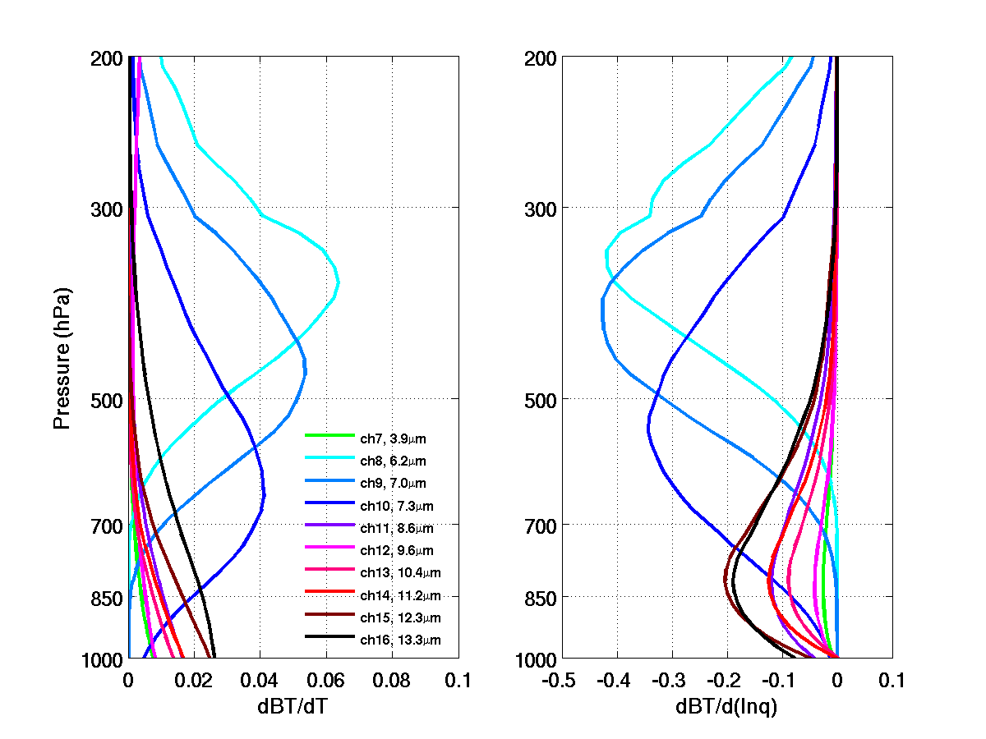
The weighting function of AHI IR bands from 8-10, and 13-16 calculated with CRTM. (standard atmosphere)

Slide 26
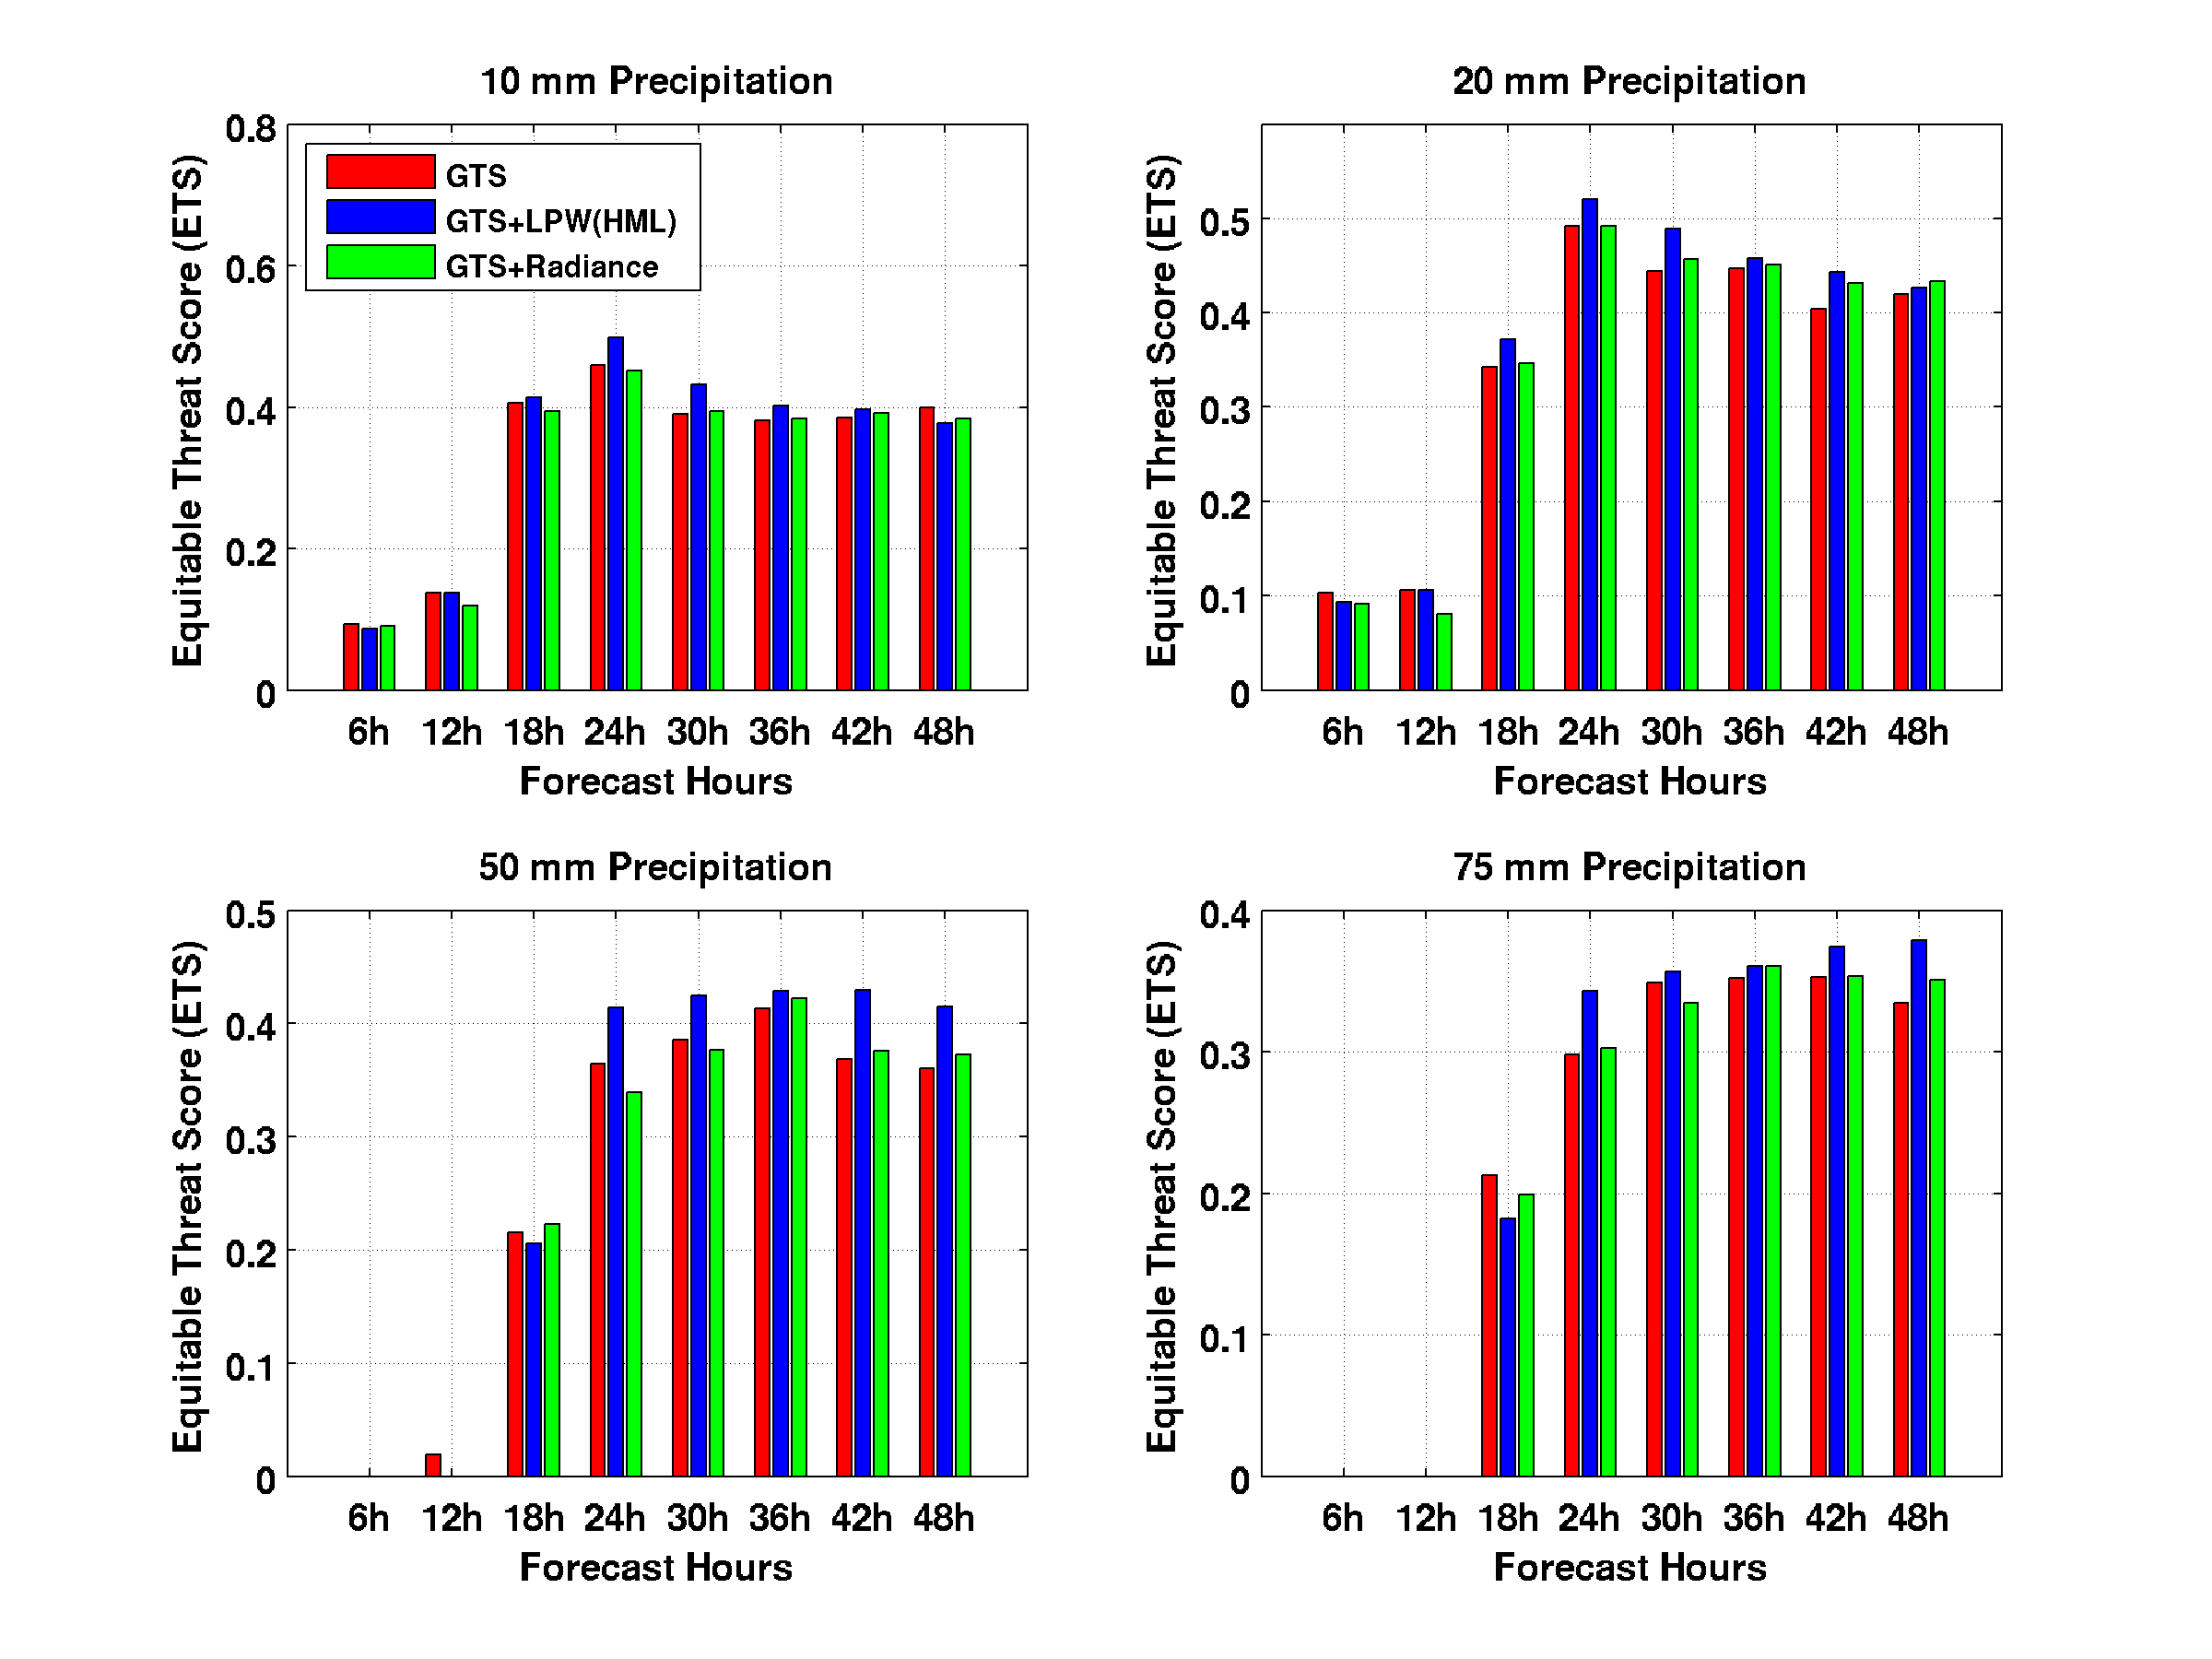
Moisture information from ABI/AHI, such as derived three layered precipitable water (LPWs) or the radiances from the three water vapor absorption bands themselves, showed improvement in rainfall forecast amounts (Wang et al., 2018), especially when combined with appropriate cumulus and microphysical parameterization schemes (Lu et al., 2019). In general three LPWs provide slightly better impact on LSS than radiances.

Slide 27
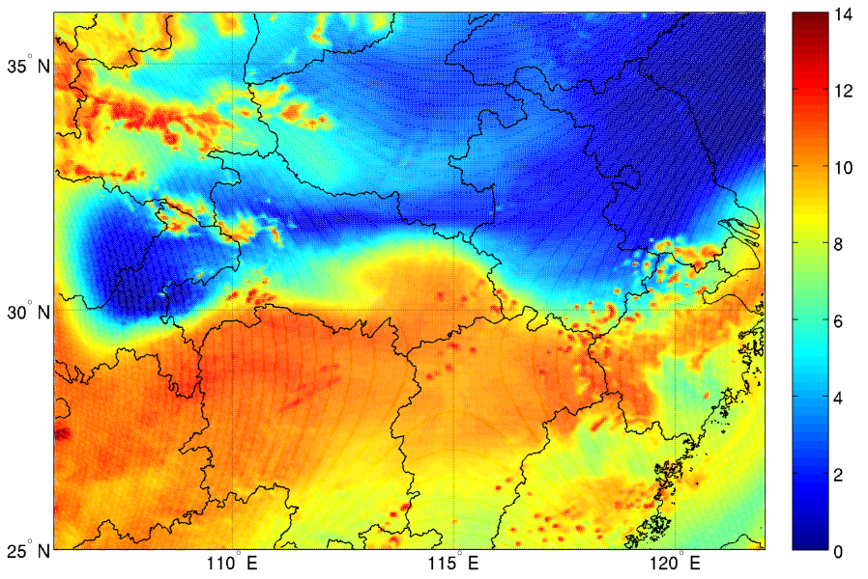
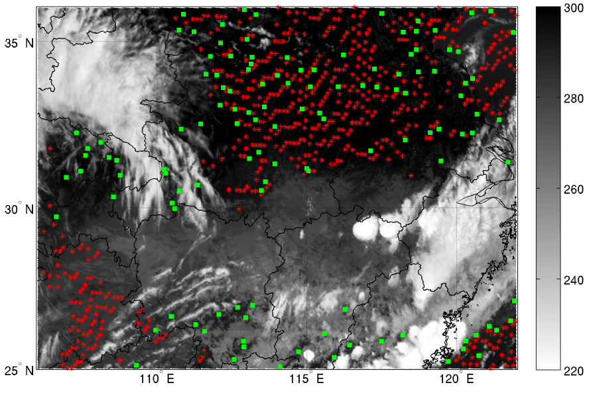
The mixing ratio (left, unit: g/kg) from background at 700 hPa, and the assimilated radiances of AHI channel 9 (right, green squares), the assimilated high layer PW (right, red stars) and the brightness temperature of AHI channel 14 (unit: K) at 0600 UTC on 18 June 2016.

Slide 28
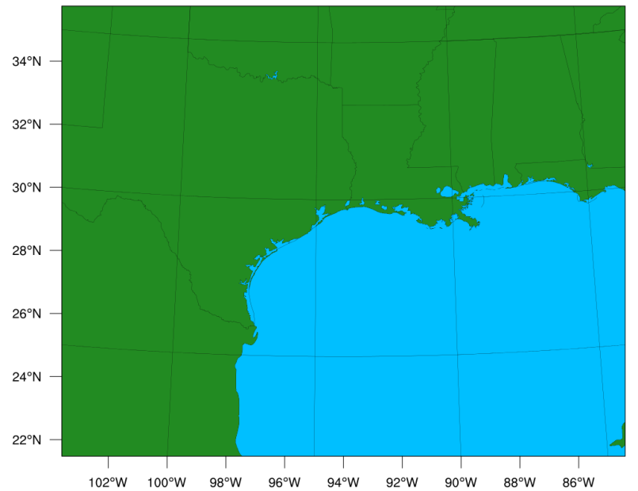
Experiments Hurricane Harvey (2017) Case
Model Domain
LPW is retrieved from ABI data
4 km horizontal resolution
Assimilated data:
CNTRL: GTS+AMSUA+IASI+ATMS+CrIS
EXP: GTS+AMSUA+IASI+ATMS+CrIS+lpw
6h
72h
24 06z
Forecast
6h
72h
Data
24 12z
Forecast
6h
72h
Data
24 18z
Forecast
6h
72h
Data
25 00z
Forecast
Data

Slide 29
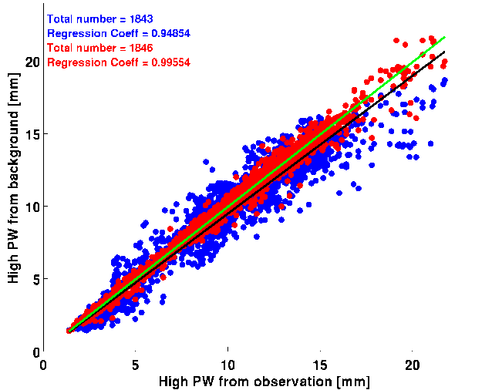
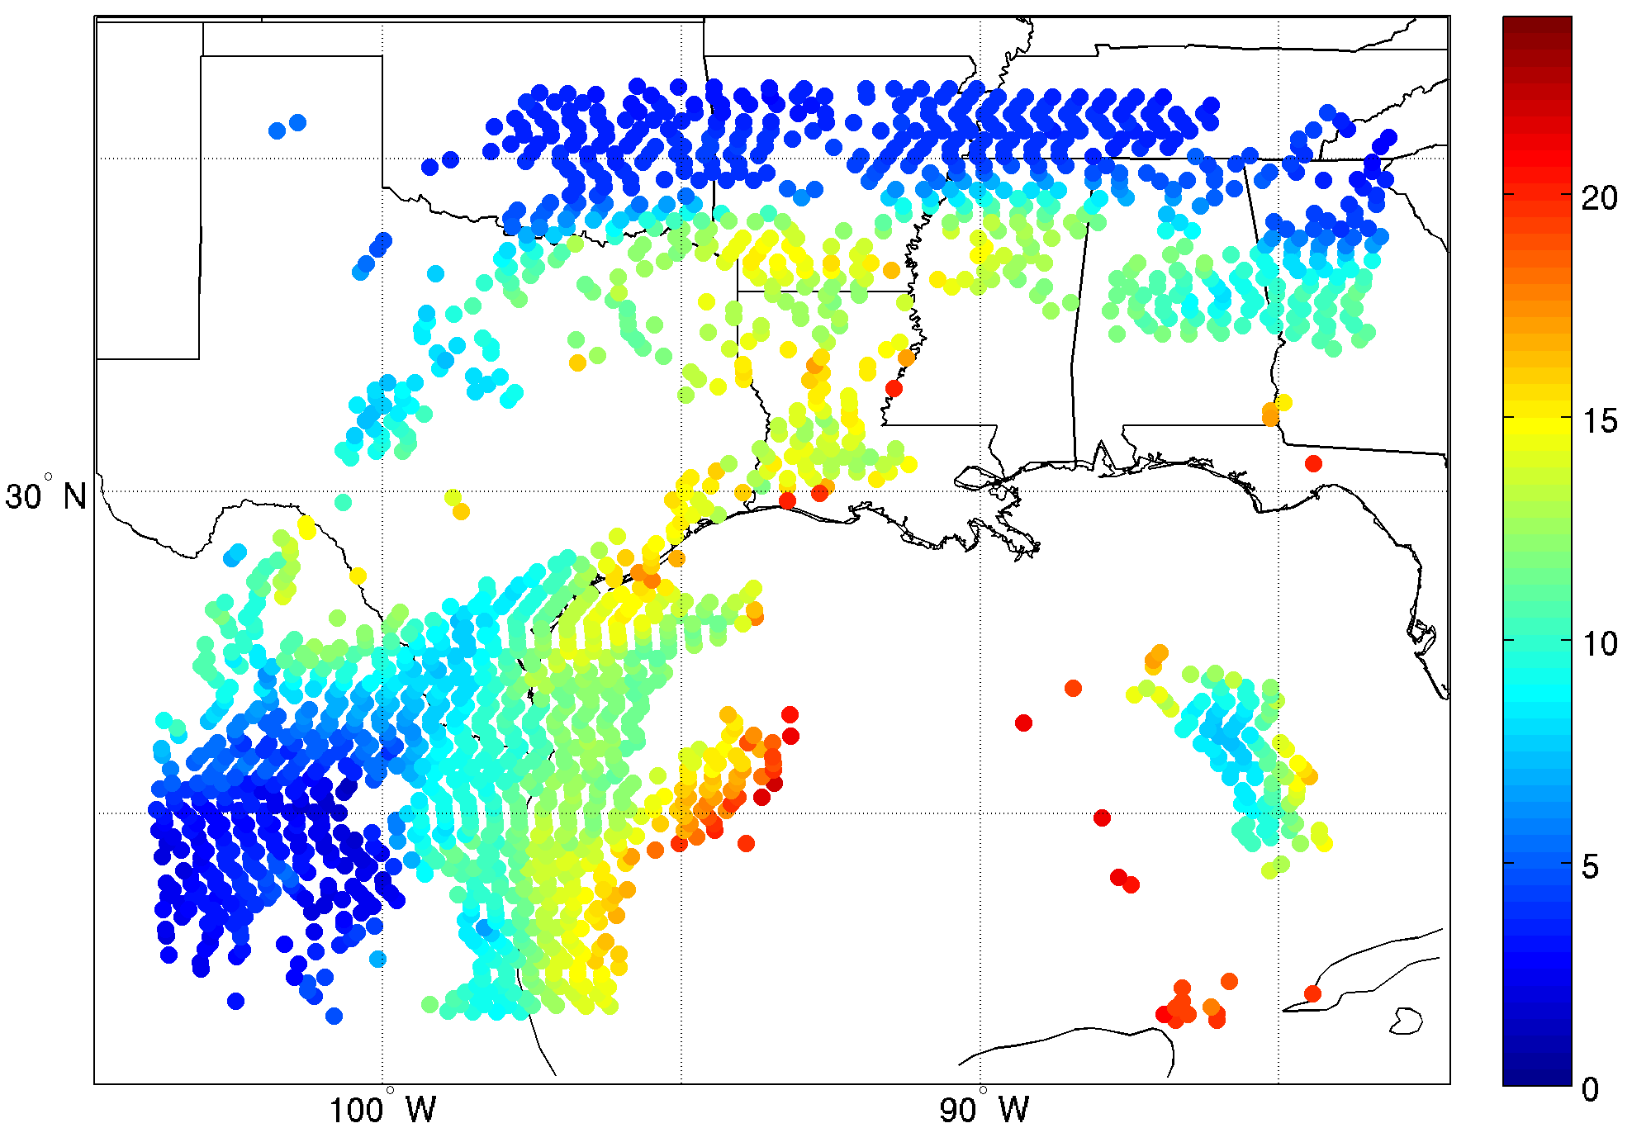
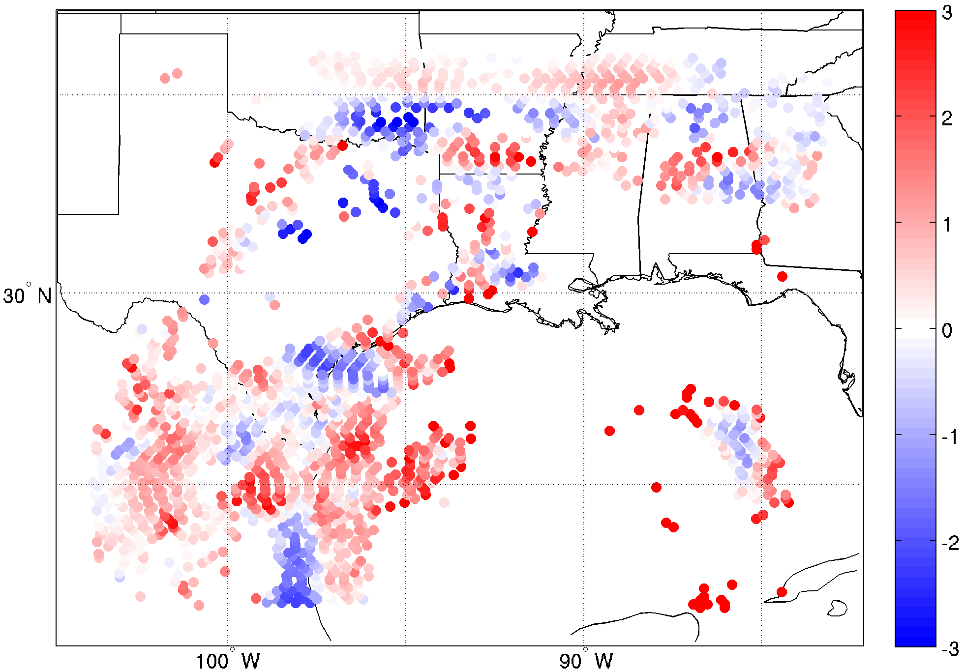
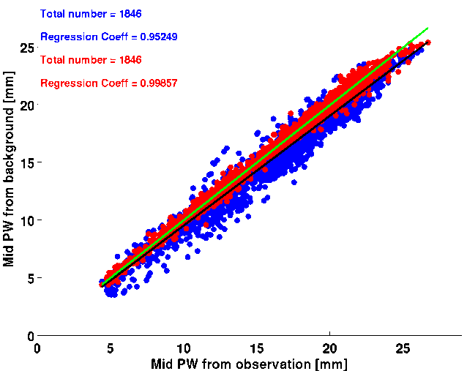
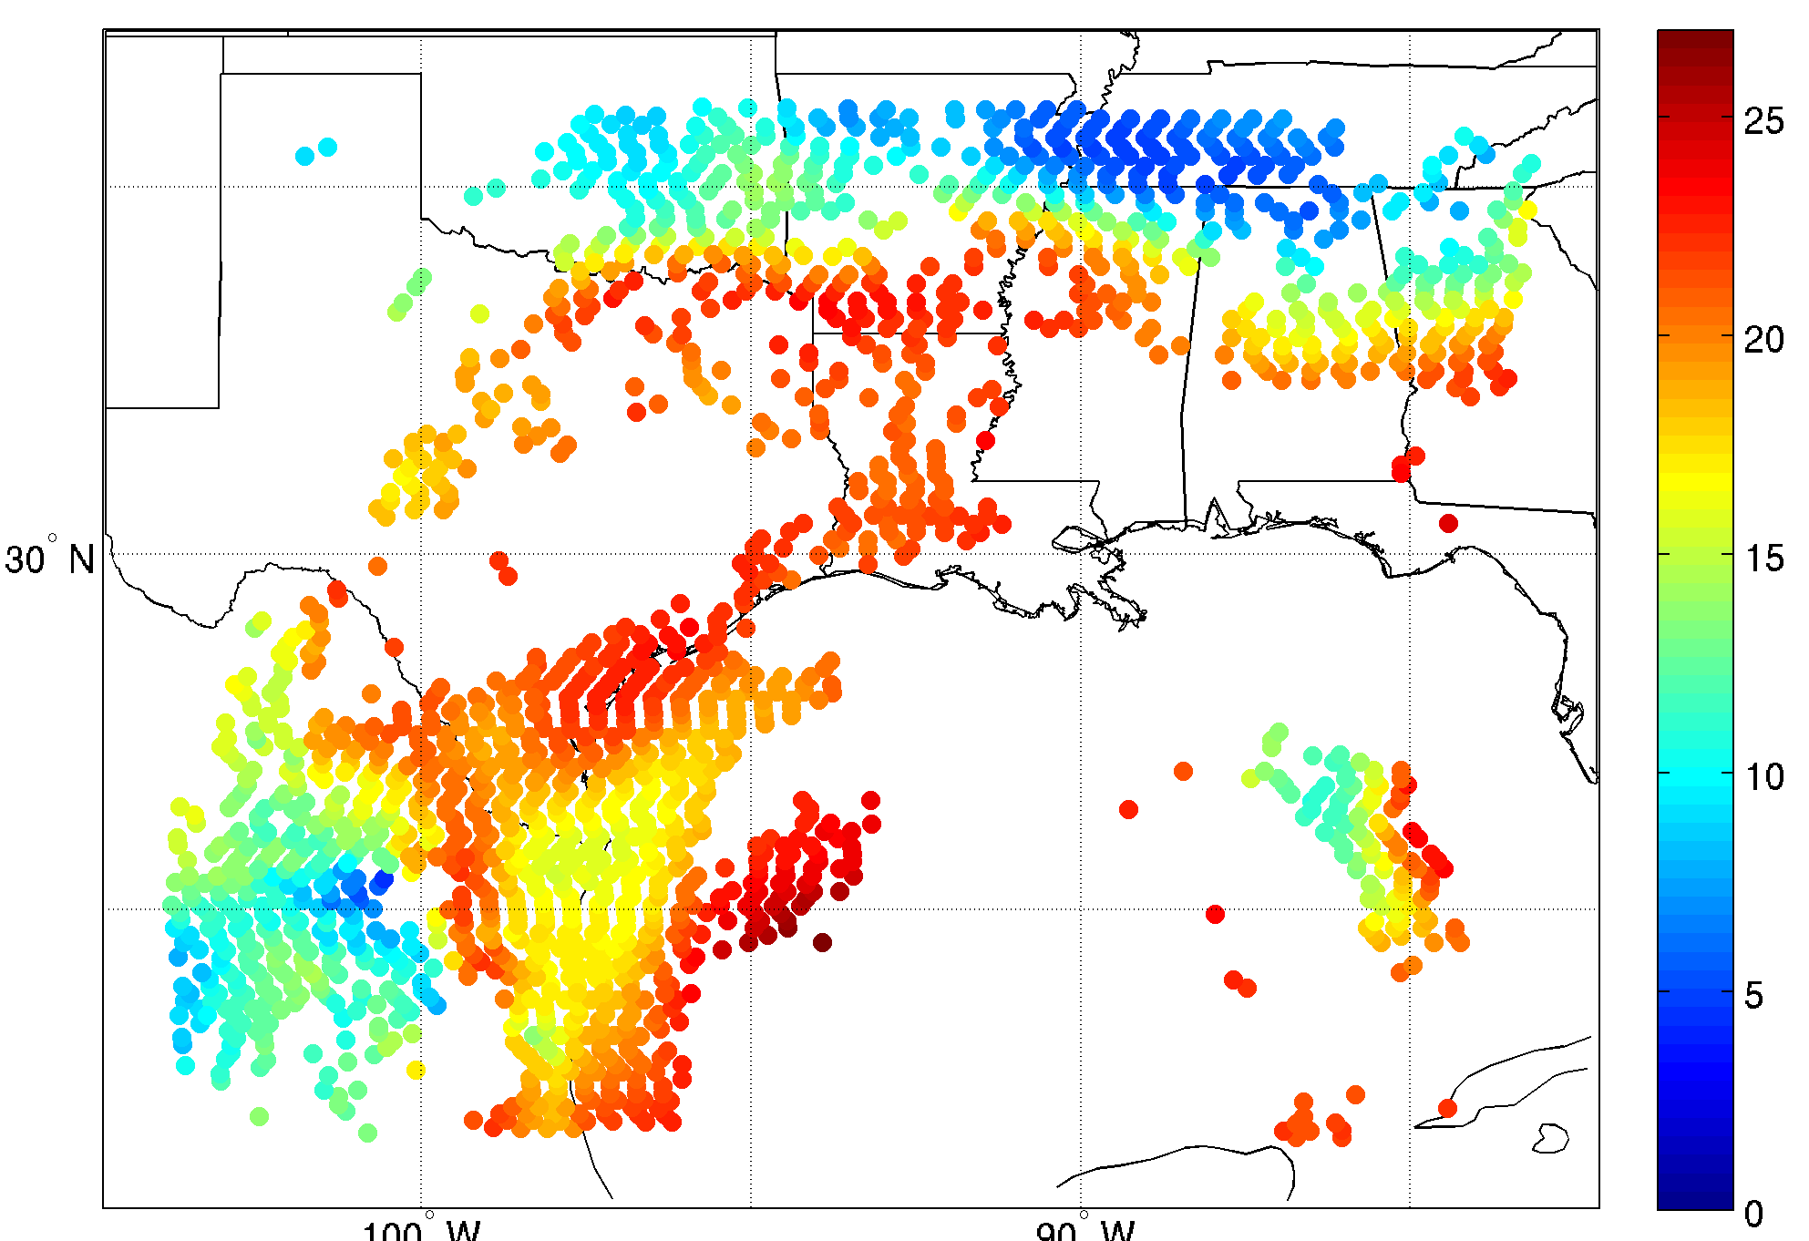
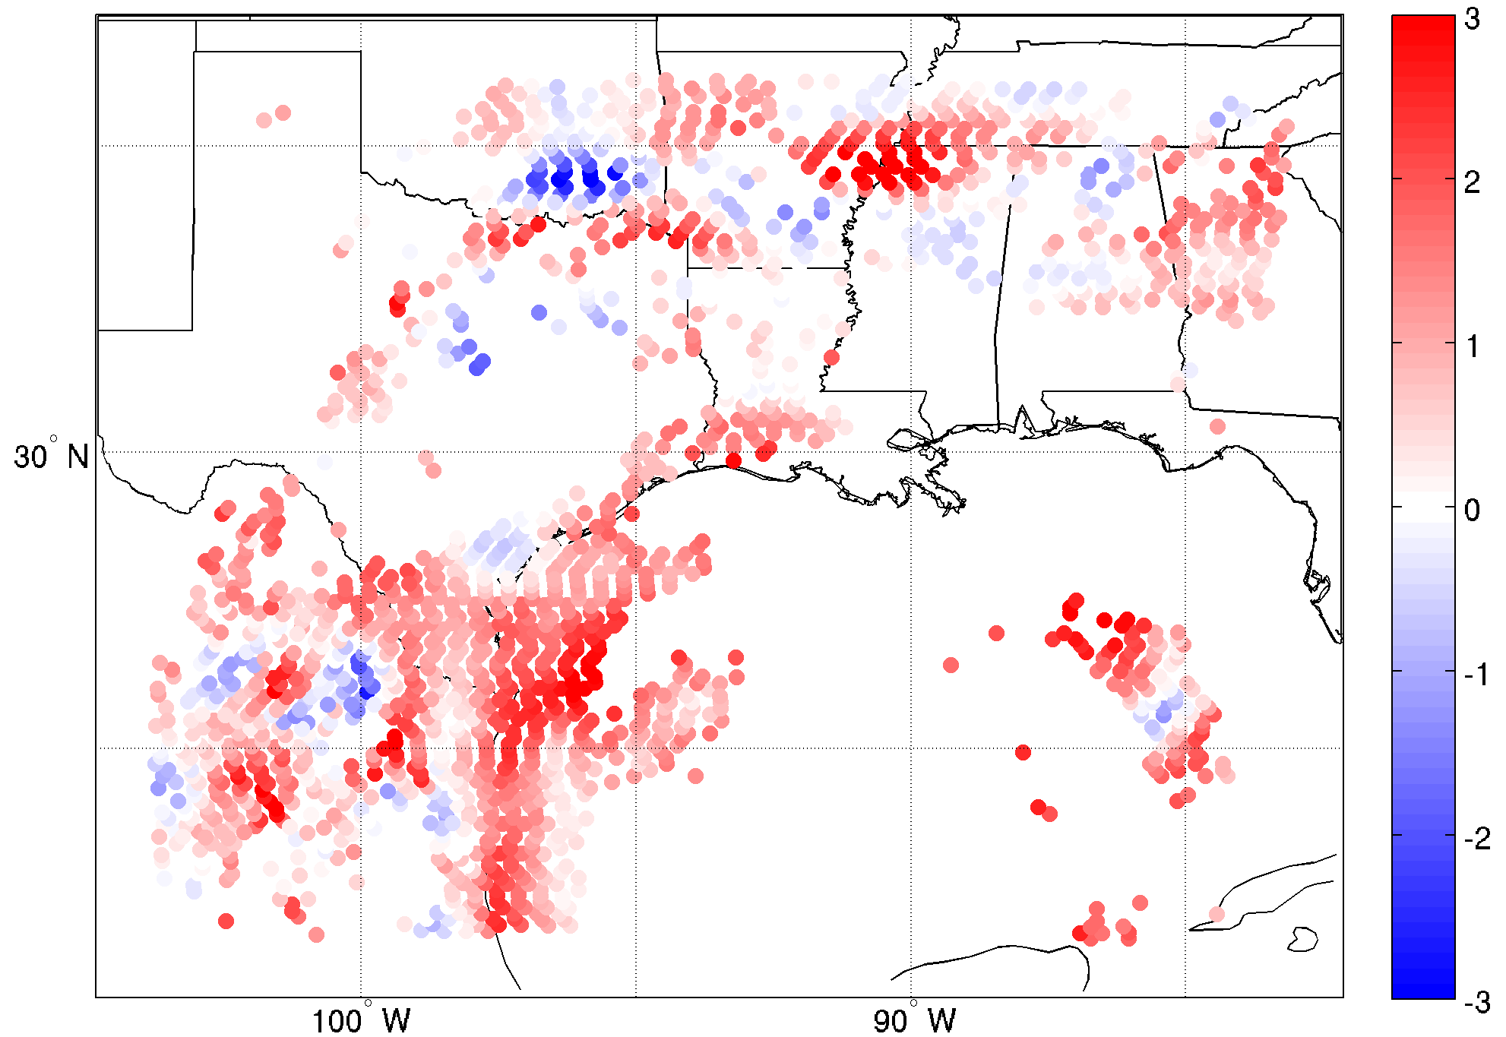
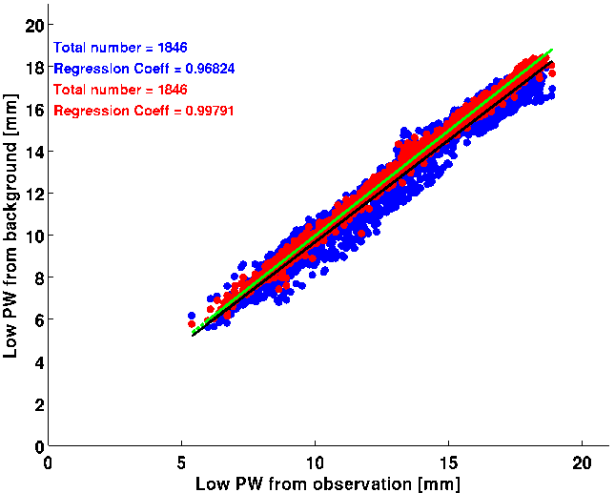
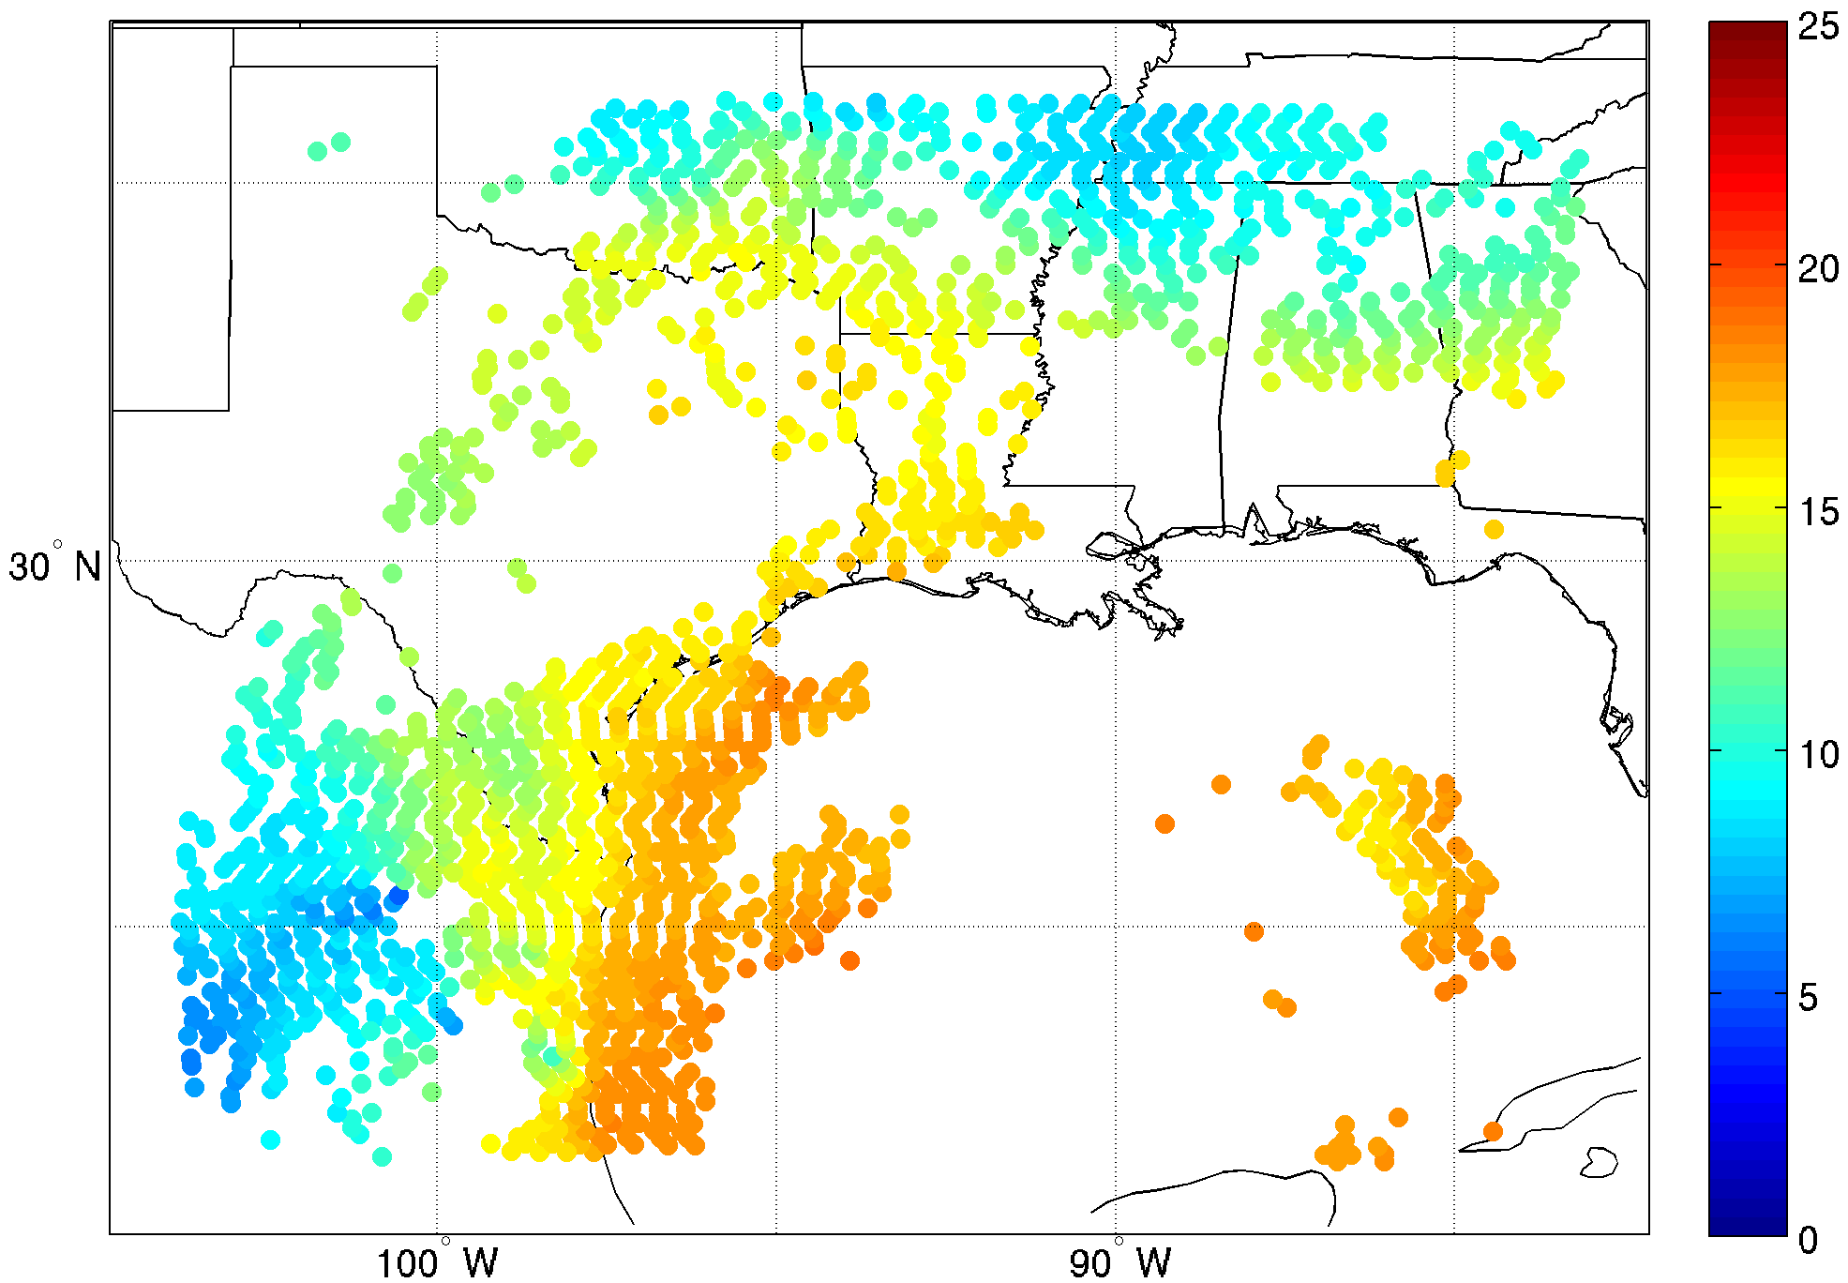
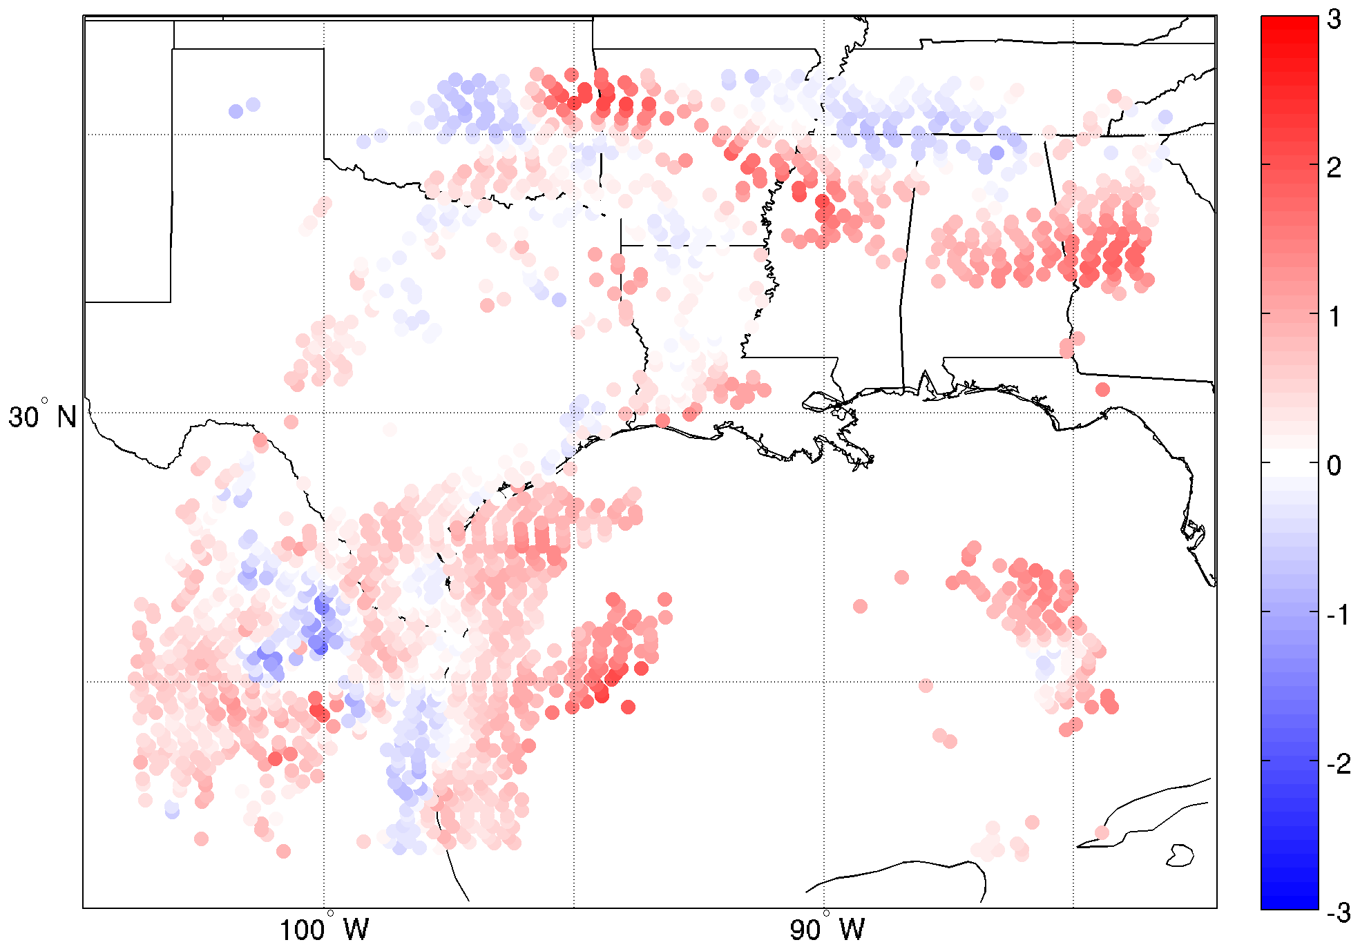
2017-8-24 06z
Low PW data
Observations
O-B
Mid PW data
High PW data

Slide 30
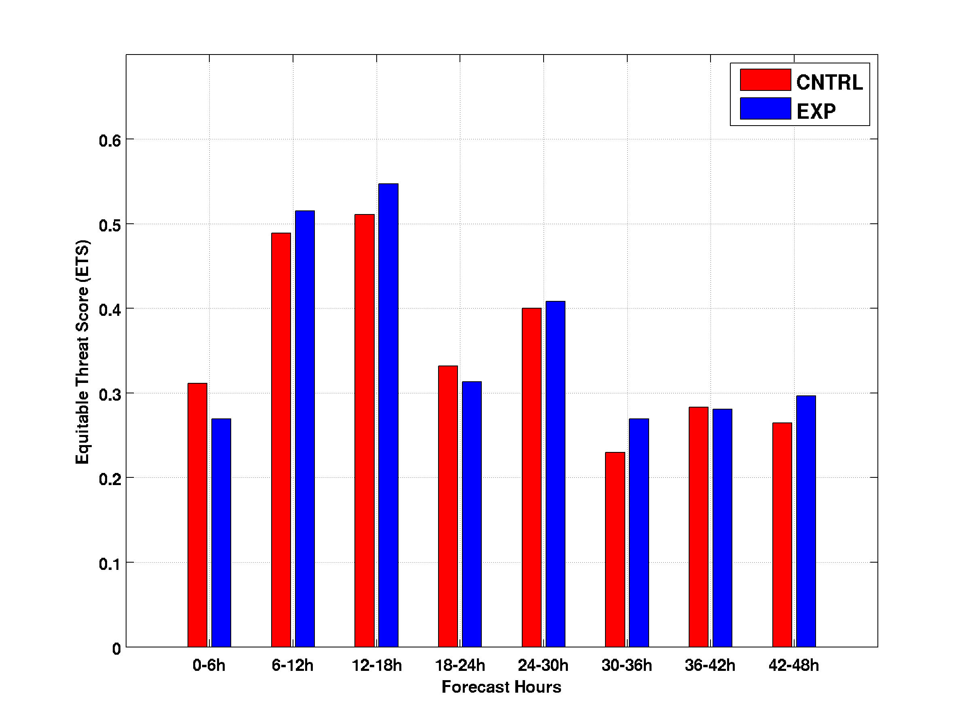
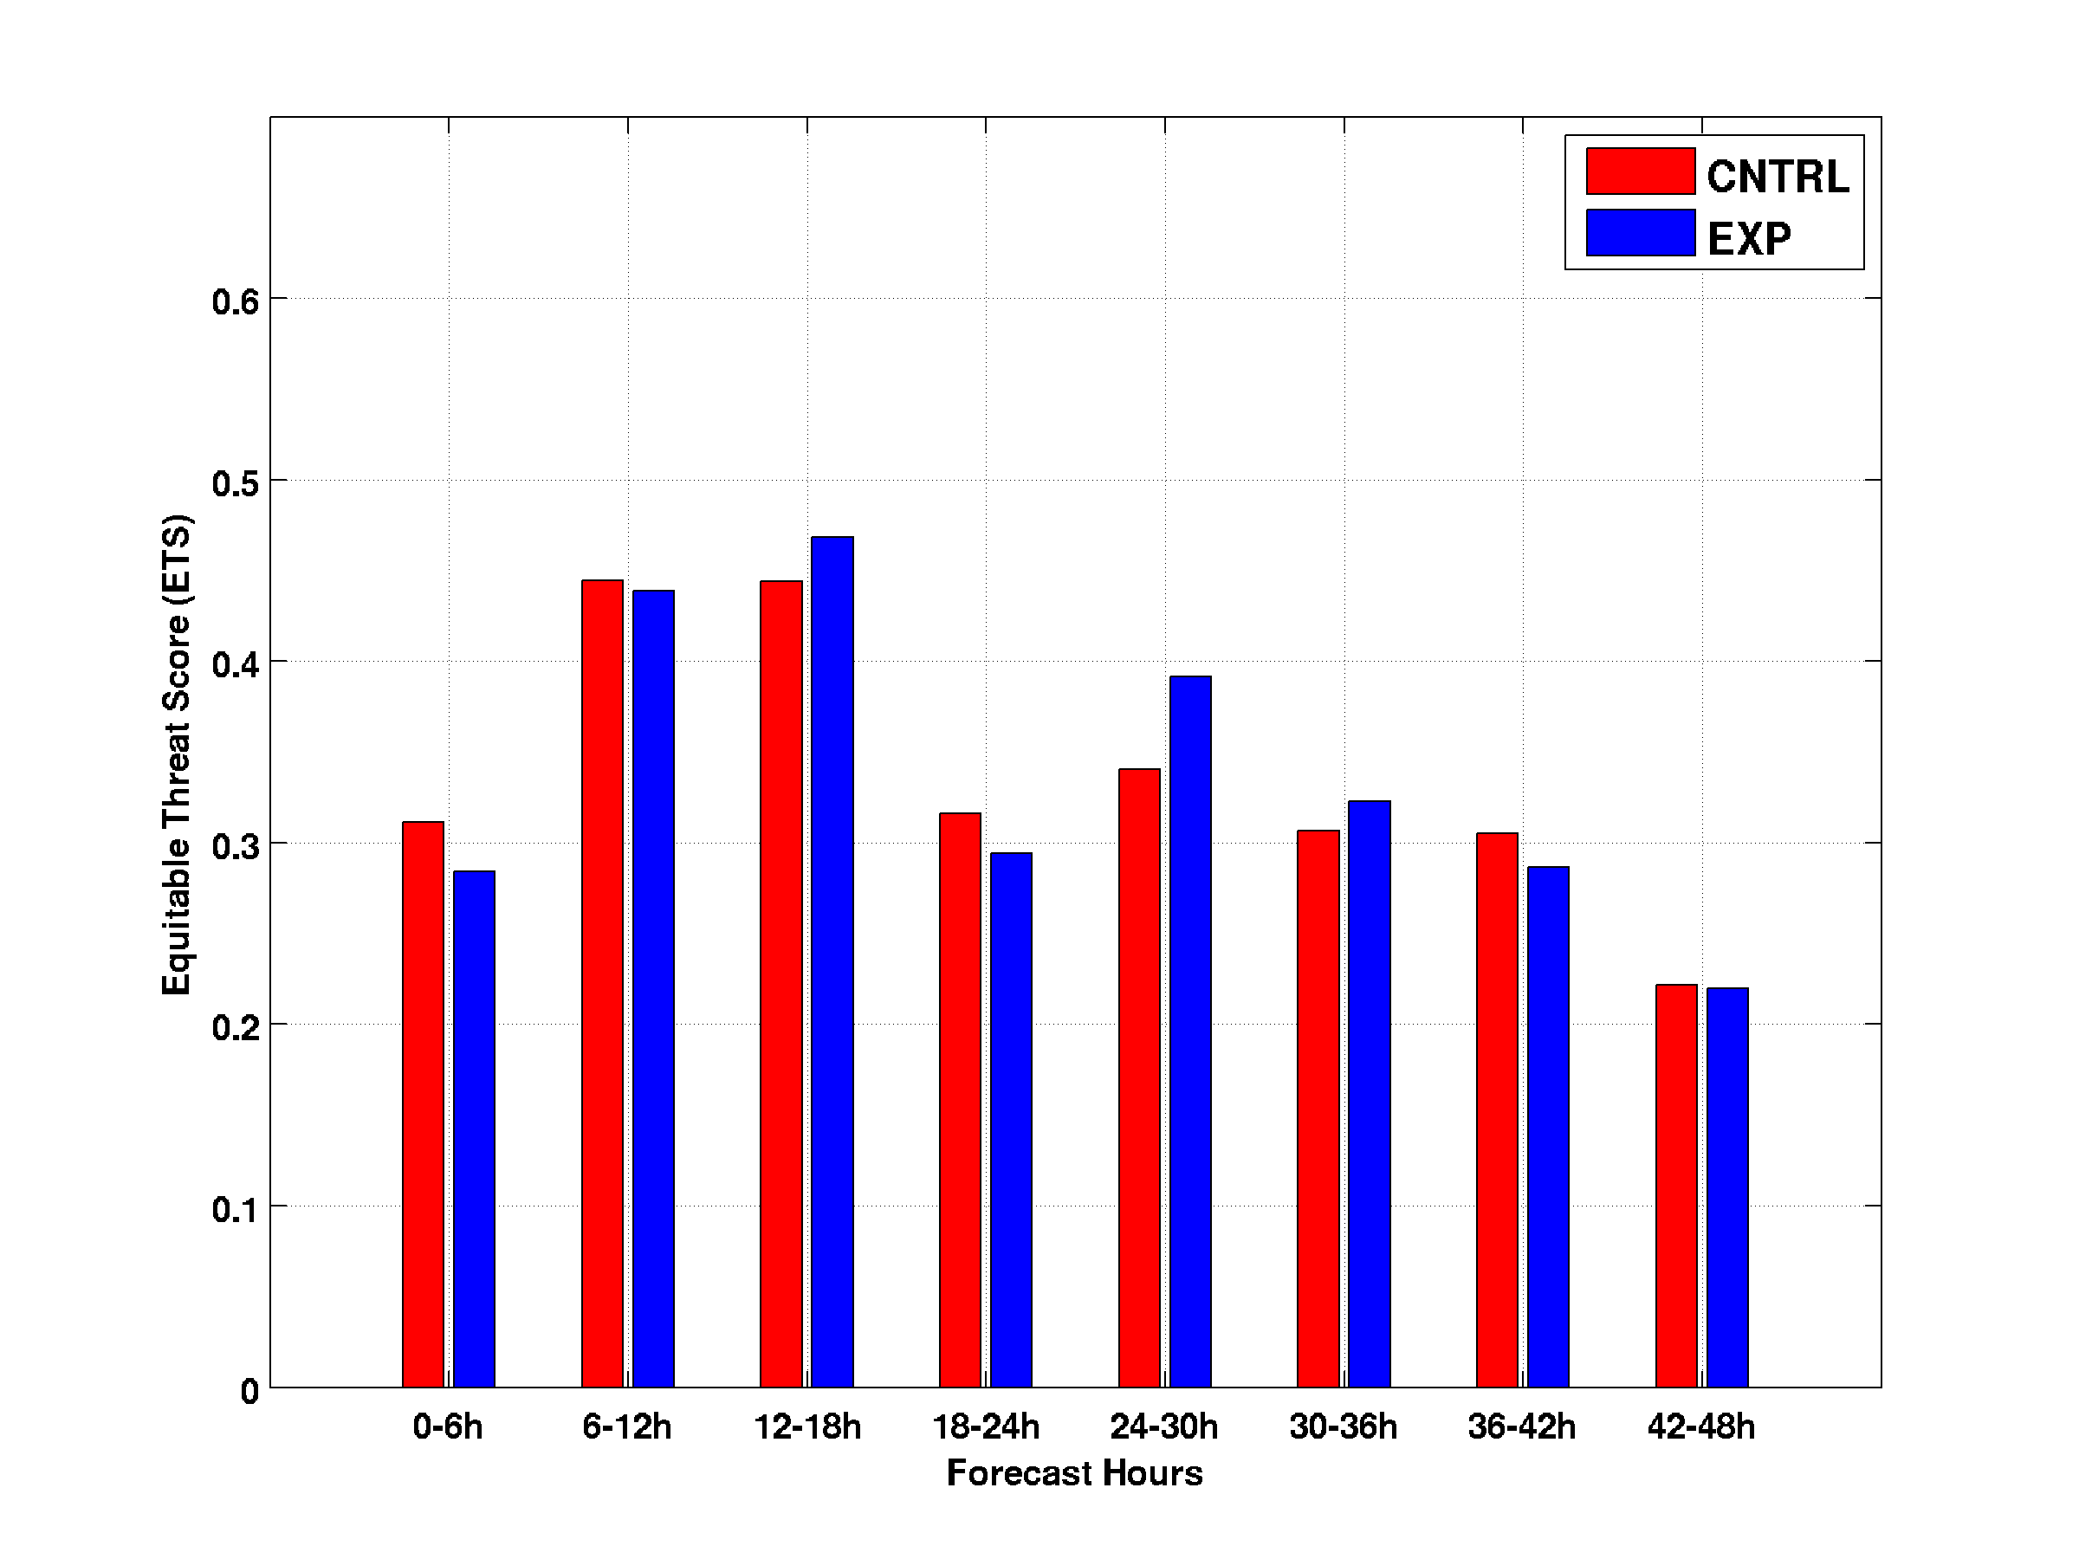
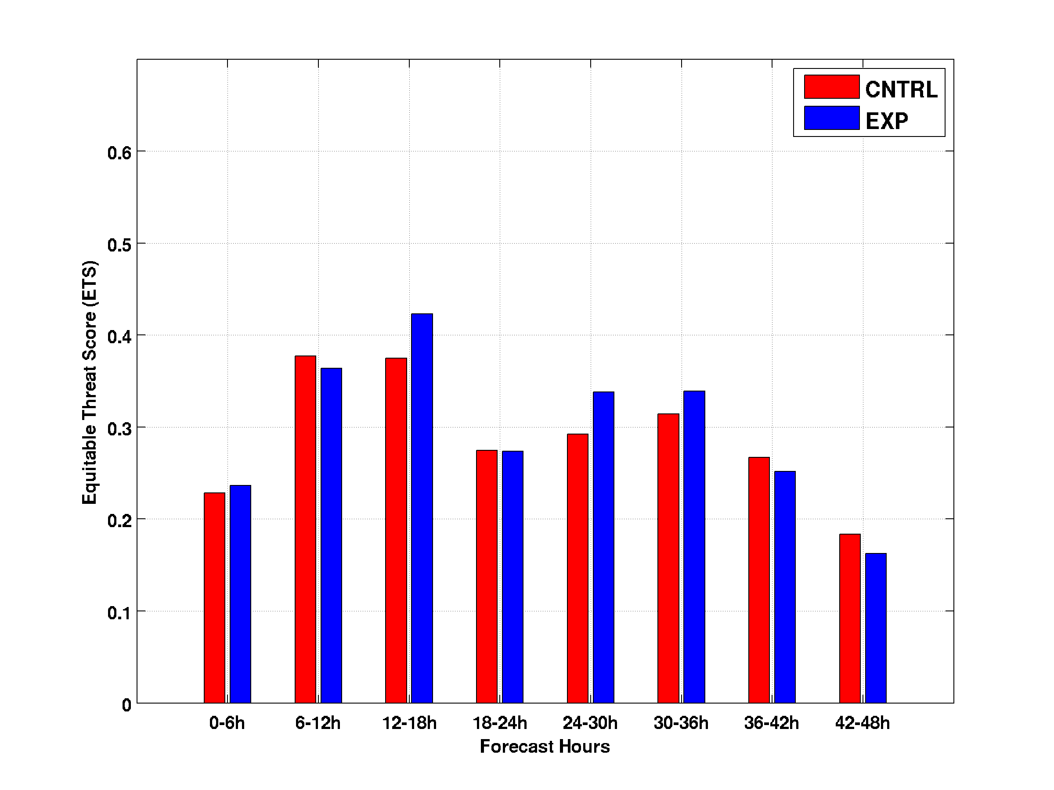
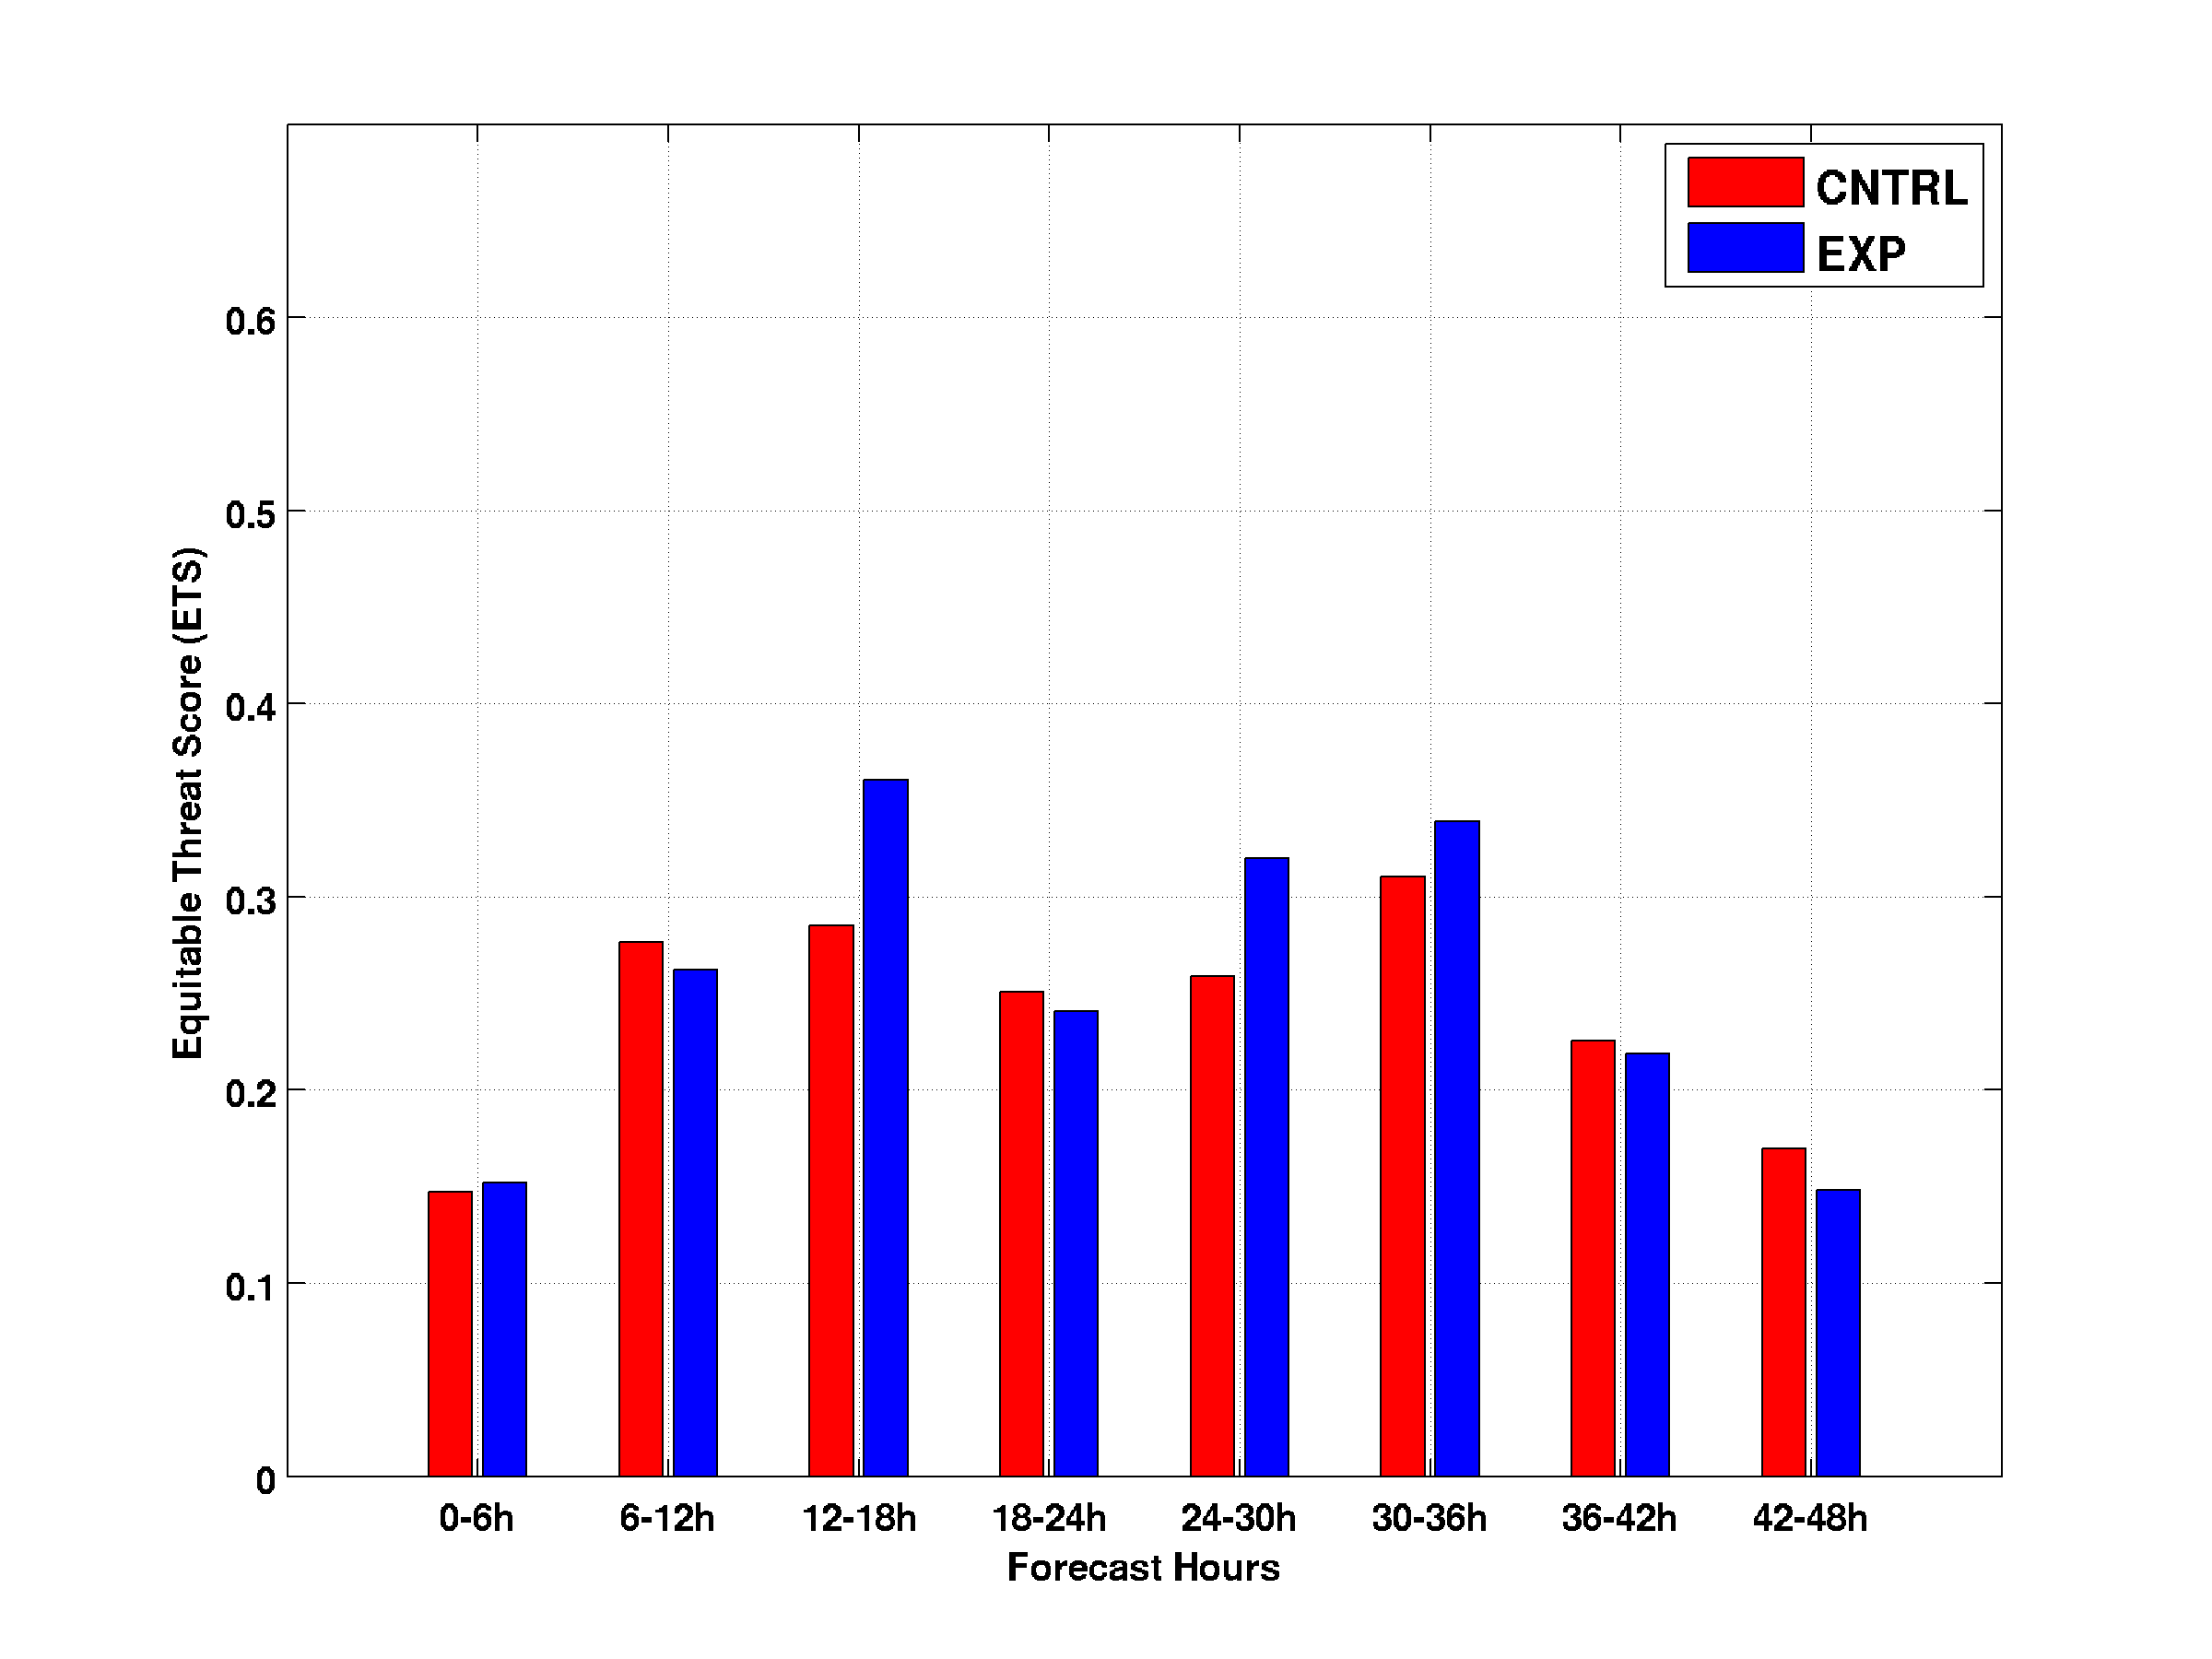
ETS scores for 06 – 48 hour precipitation forecasts
1 mm precipitation (and >)
10 mm precipitation (and >)
15 mm precipitation (and >)
20 mm precipitation (and >)
CNTRL: operational approach
EXP: CNTRL+ABI moisture
Larger number means better

Slide 31
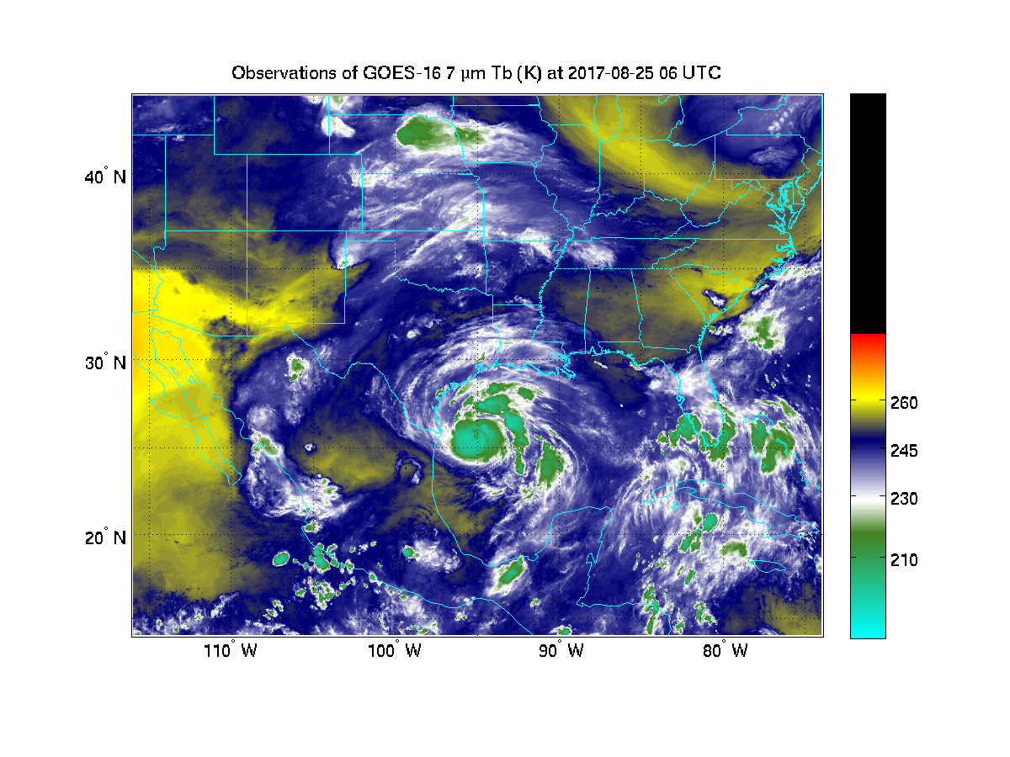
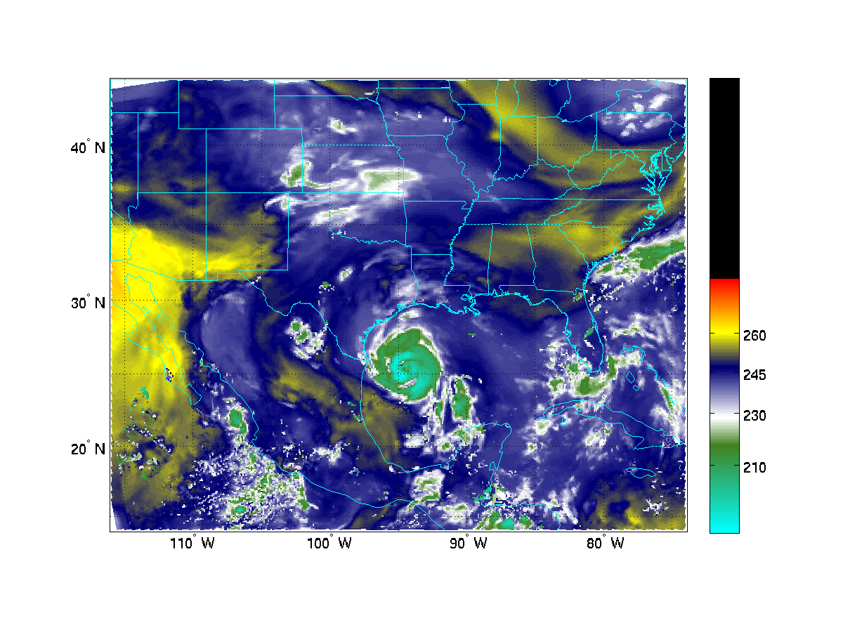
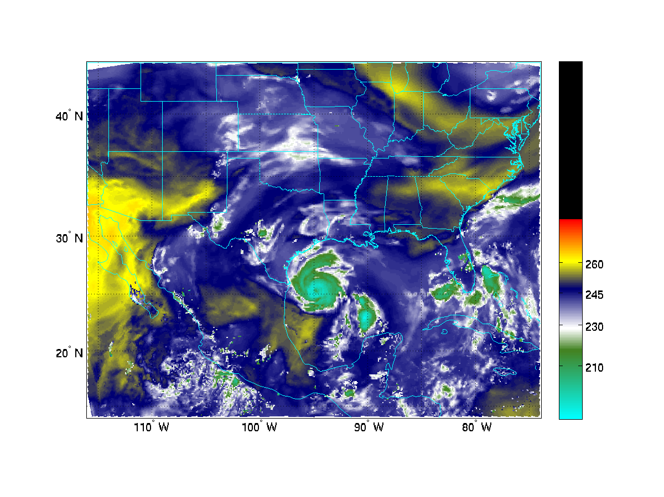
BT of GOES 16 6.95 µm band from 2017-8-25 06z to 8-28 06z
Observations
CNTRL
CNTRL+ABI
Better moisture distribution

Slide 32
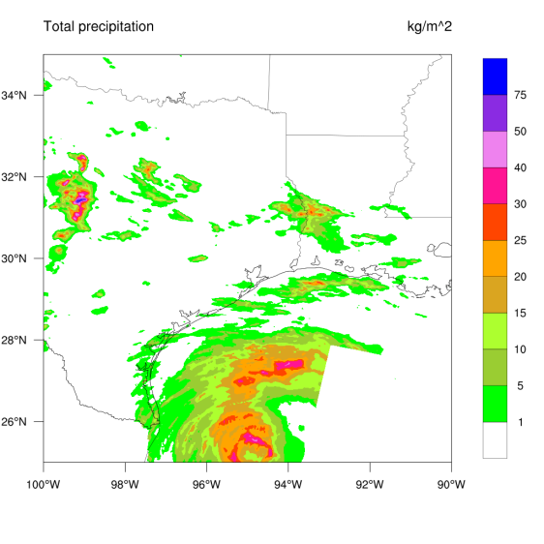
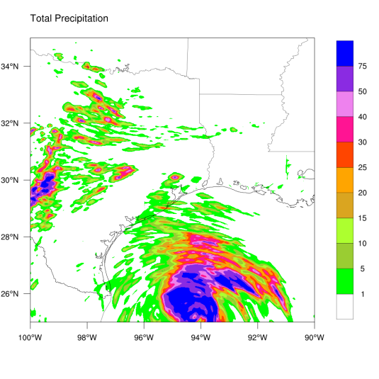
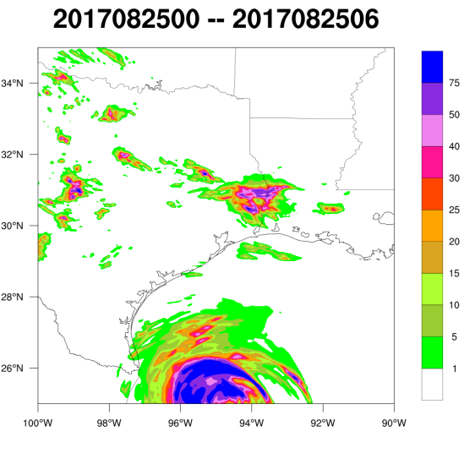
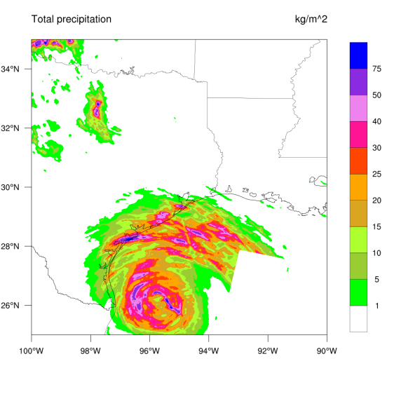
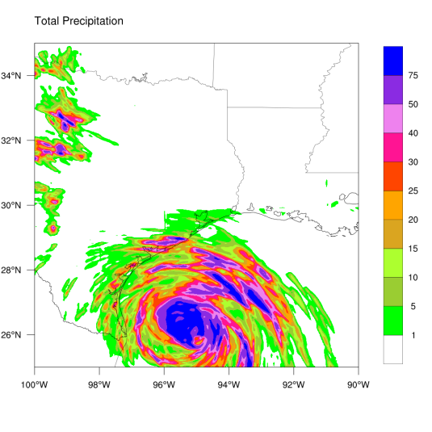
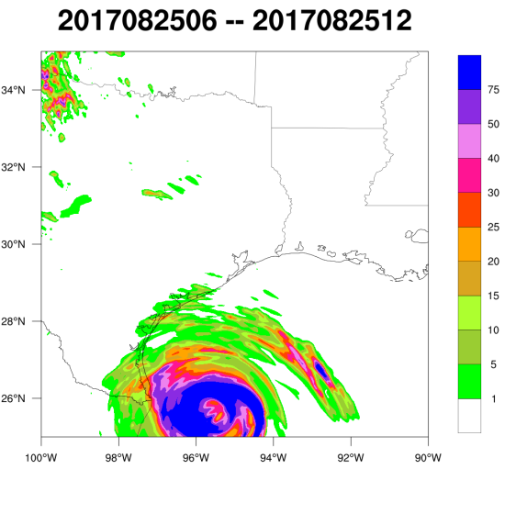
Obs
HRRR
Exp
6 h forecasts
25 06z
Heavy Precipitation (> 100 mm/6hr) over land
6-hour cumulative precipitation forecasts started at 00 UTC on 25 August 2017
12 h forecasts
25 12z
Two Rainbands
18 h forecasts
Two Rainbands
25 18z

Slide 33
ABI rapid scan AMVs for three typical 2017 Hurricane cases with HWRF
Harvey case:
2017082306 – 2017082612 (14 analysis cycles)
Irma case:
2017090418 – 2017091000 (22 analysis cycles)
Maria case:
2017091700 – 2017092318 (28 analysis cycles)
Total analyses/forecasts: 64

Slide 34
HWRF/S4
First step:
Implement NOAA model and assimilation system into CIMSS research environment, and assure the same results between CIMSS research testbed (upper) and the NOAA operation (lower).
HWRF/Op

Slide 35
Impacts of ABI rapid scan AMVs on individual hurricane tracks (RMSE): on top of all other observations used operationally
Irma
Harvey
Maria

Slide 36
Summary
Data latency directly affects the amount of data that can be assimilated in NWP system, the impacts have the following order: no latency > 1-hour latency > 2-hour latency >3-hour latency. Such low latency LEO data can be obtained via DB sites;
GEO based high temporal and spatial resolution moisture and dynamic information, especially the rapid scan based mesoscale AMVs in the inner core region is very useful for improving tropical cyclone forecasts, such information can be obtained via GRB system;
Efficient data processing is critical to assure low latency from LEO and GEO for applications.

